Slide 1
History of EU climate policy
Rahat Sabyrbekov
OSCE Academy

Slide 2
1970s - debating
1950s
Concern about global climate change dates back as far as the 1950s, but until the 1970s it was mainly regarded as a scientific issue with little if any policy relevance.
1972
The 1972 Stockholm Conference agreed to intensify scientific research, a task later taken up by the newly created United Nations Environment Programme (UNEP)
1970s
Throughout the 1970s, a debate had raged between scientists over whether the climate was warming or even cooling.
Notes:
Concern about global climate change dates back as far as the 1950s, but until the 1970s it was mainly regarded as a scientific issue with little if any policy relevance.
The 1972 Stockholm Conference agreed to intensify scientific research, a task later taken up by the newly created United Nations Environment Programme (UNEP)
(Sjöstedt 1998: 233). In 1979, UNEP and the World Meteorological Organisation (WMO) organised the First World Climate Conference (Pallemaerts and Williams
2006: 22). However, it conspicuously failed to attract any policy makers (Bodansky 2001: 24). In the EU, the Commission adopted a multi-annual research programme
on climatology (OJ L12, 17.1.80: 24), aimed at investigating the underlying scientific issues rather than exploring its governance.

Slide 3
1980s – raising awareness
These scientific discussions culminated in a major agenda-setting conference held in Villach, Austria, in October 1985. the issue of climate change was therefore beginning to move slowly from the broader systemic agenda to the institutional agenda of issues which directly concern policy makers.
Period of heightened environmental awareness internationally and also a point at which the EU’s involvement in national environmental matters was beginning to accelerate,
Adoption of the Single European Act in 1987.

Slide 4
Energy security and/or Environment
Crucially, the EU lacked the legal competence to involve itself in energy matters, and Member States were fiercely opposed to its becoming any more involved in what they perceived to be their own sovereign affairs.
Climate change was still being framed mainly as an atmospheric environmental problem, not an energy security one, so the scope for hitching climate change onto the back of energy policy was not great.
- SAVE, ALTENER
Notes:
For example, in 1986 the EU adopted a non-binding target of improving the efficiency of final energy use by at least 20% by 1995 (Haigh 1996:
159). When, in 1988, it became apparent that this would not be met, the EU began to develop more detailed policy programmes such as SAVE (on energy efficiency) and
ALTENER (covering renewables), on which more will be said below.

Slide 5
Early 1990s – global impetus
In 1987, the US government issued a proposal to create an Intergovernmental Panel on Climate Change (IPCC).
In July 1988, the Commission created an interservice group to ‘elaborate … preliminary ideas’ about ‘possible Community action in respect of the “Greenhouse Issue”’
It effectively marked the commencement of formal climate policy making in the EU
Notes:
Established in 1988, the IPCC was a conscious attempt to institutionalise the rapidly developing debate about climate change by moving it
out of scientific realms and into the international political system (Pallemaerts and Williams 2006: 22). Encouraged by the apparent success of the 1987 Montreal
Protocol on ozone depletion, the Canadian government organised a world climate conference in June 1988 to debate the science and, importantly, the policy implications
of climate change. Known as the Toronto Conference, it has been described as the ‘first major international gathering to have global warming as its principal foci’
(Rowlands 1995: 74).
Climate change was, in other words, now firmly on the EU’s institutional agenda.

Slide 6
1988–1992: the EU’s first bid for international leadership
November 1989 the first high-level meeting in Nordwijk identified many of the key legal principles – such as states having ‘common but differentiated responsibilities’ to tackle climate change.
By 1990, the majority of Member States had established national emission reduction plans and/or targets (Costa 2008: 534).
Yet there remained no common EU target.

Slide 7
Not everybody is excited
Deep divisions between the greener Member States (e.g. Denmark, Germany and the Netherlands), which had stricter national targets, and the so-called cohesion states (Greece, Spain and Portugal), which either had weaker targets or had none at all
Targets and long-term aims, not to the ‘policies and measures’
1990s – several major failures to develop common actionable policy ( e.g. Carbon tax).
Notes:
* A framework Directive to conserve energy and improve energy efficiency (within the existing SAVE programme);
A Decision to support the development of renewable energies (ALTENER);
* A Decision concerning a monitoring mechanism for CO2 emissions; and
* A Directive to introduce a combined tax on the carbon/energy content of fuels.

Slide 8
Start of international climate leadership
“Very quickly environmental policy – and with it the fledgling policies on climate change – became the lamb which the then Commission President, Jacques Delors, seemed quite prepared to sacrifice to save the wider integration process.”
Against expectations, hopes began to grow after the UK and Germany announced their readiness to cut their emissions in the period to 2010.
The role of USA was important

Slide 9
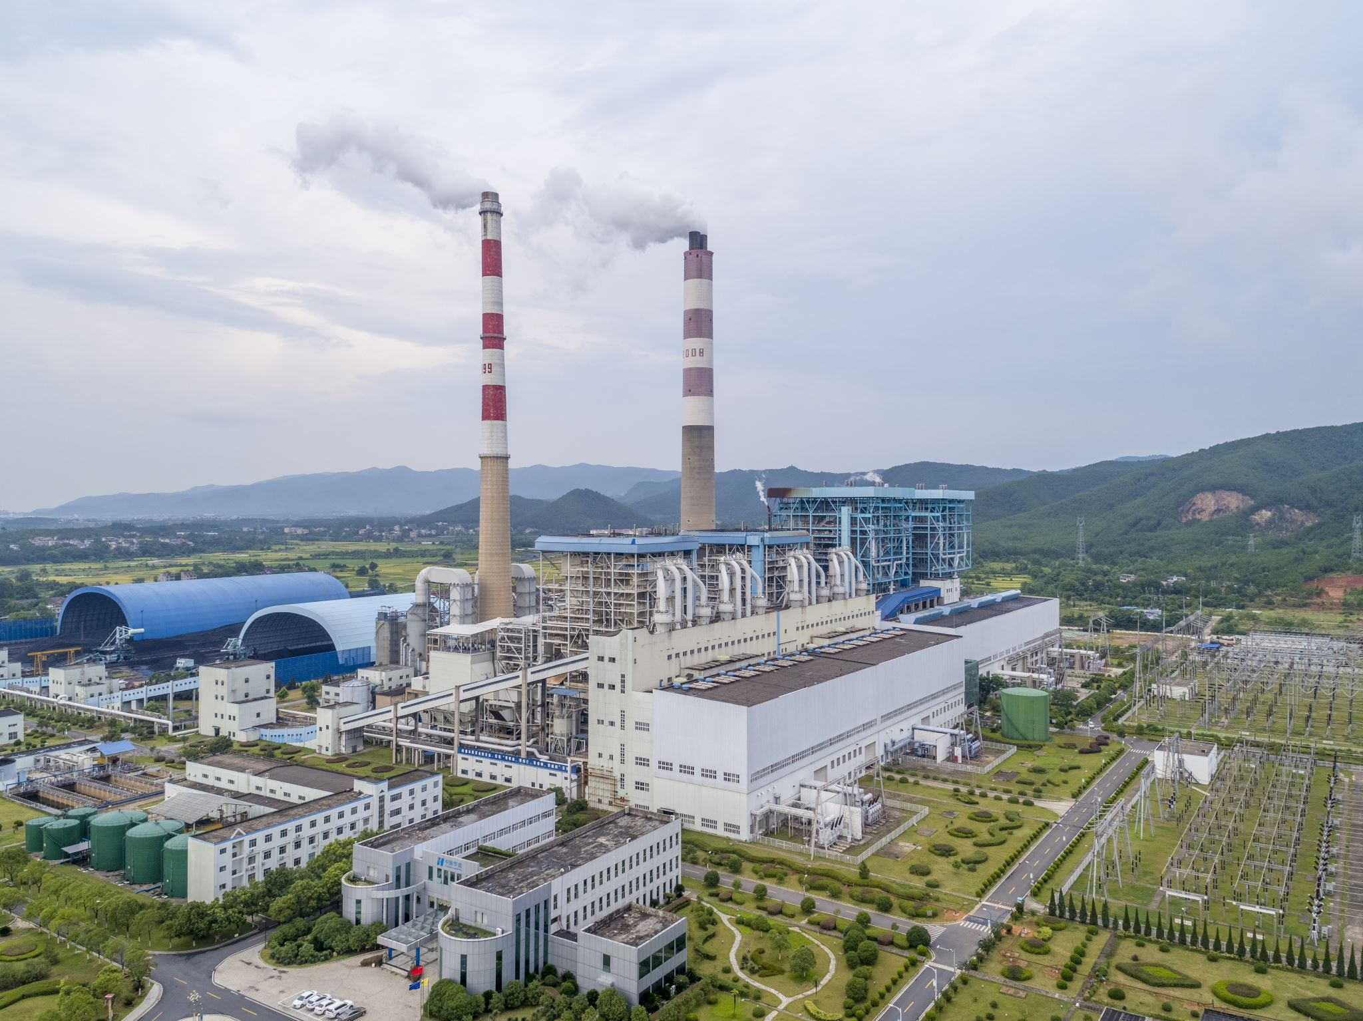
Introduction to Kyoto Protocol
Kyoto Protocol is an international agreement aimed at reducing greenhouse gas emissions
It was adopted in 1997 and came into force in 2005
The protocol was developed under the United Nations Framework Convention on Climate Change (UNFCCC)

Slide 10
Objectives of Kyoto Protocol
The primary objective of the Kyoto Protocol is to reduce the emissions of greenhouse gases that contribute to global warming
The protocol sets binding targets for developed countries to reduce their greenhouse gas emissions by a certain percentage below 1990 levels
The protocol also establishes a framework for emissions trading and the Clean Development Mechanism (CDM), which allows developed countries to offset their emissions by investing in emissions-reducing projects in developing countries

Slide 11
Results of Kyoto Protocol
The Kyoto Protocol has been successful in raising awareness about climate change and the need to reduce greenhouse gas emissions
The protocol has helped to establish a framework for international cooperation on climate change mitigation
However, the overall impact of the protocol on reducing greenhouse gas emissions has been limited, as many countries have not met their emissions reduction targets and some major emitters, such as the United States, did not ratify the protocol.

Slide 12
The EU’s bid for international leadership
After 1997, the debate about climate change inside the EU began to develop more quickly.
- March 1997 harmonization of fuel tax, carbon/energy tax in 2003
Strong support for Kyoto protocol
The Emissions Trading Directive was eventually adopted just over two years later in 2003 and its first (pilot) phase of operation commenced in 2005

Slide 13
Complying with Kyoto and preparing for the post-2012 period
IPCC’s Fourth Assessment Report in 2007 climate change was occurring and will cause significant impacts and it was delivered with much greater confidence and political assertiveness.
Developments in the underlying science gradually began to feed through into policy analysis.
Around the same time, the UK Treasury published a review of climate change economics, which captured significant global attention (Stern 2006).

Slide 14
Complying with Kyoto and preparing for the post-2012 period
In the mid to late 2000s, the EU’s growing political determination to play a leading role in relation to climate policy
Later that year, the Commission followed up with an action plan on energy efficiency which aimed to reduce consumption by 20% by 2020
In Limiting Global Climate Change to 2 Degrees Celsius – The Way Ahead for 2020 and Beyond, the Commission called for a range of new policies for a 20% reduction in emissions by 2020 ‘to demonstrate international leadership’, rising to 30% if other states agreed to a post-2012.

Slide 15
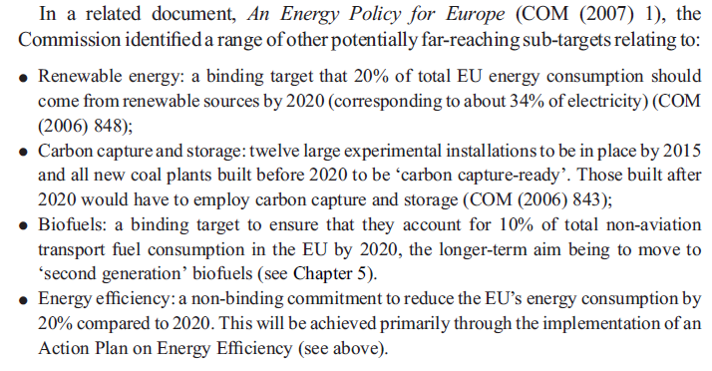

Slide 16
Conclusion
EU climate policy evolved slowly and stepwise since the 1970s
National policies had more impact than EU policies until the 2000s
Since c. 2000, the EU has adopted increasingly distinct policies and targets for climate change
EU policies now encompass a wider array of instruments than traditional environmental policies
The EU Green Deal is a comprehensive set of policy initiatives and legislative proposals announced by the European Commission in December 2019.

Slide 17
A brief history of EU environmental policy
https://www.youtube.com/watch?v=9y2jcrxnoKM

Slide 18
Thank you! Questions
r.Sabyrbekov@osce-academy.net

