Slide 1
EU Green Deal
Rahat Sabyrbekov
OSCE Academy
Bishkek
April 2023

Slide 2
Communication from the Commission to the European Parliament, the European Council, the Council, the European Economic and Social Committee and the Committee of the Regions the European Green Deal, 2019
‘a new growth strategy that aims to transform the EU into a fair and prosperous society, with a modern, resource-efficient and competitive economy where there are no net emissions of greenhouse gases in 2050 and where economic growth is decoupled from resource use’ EU Commission, 2019

Slide 3
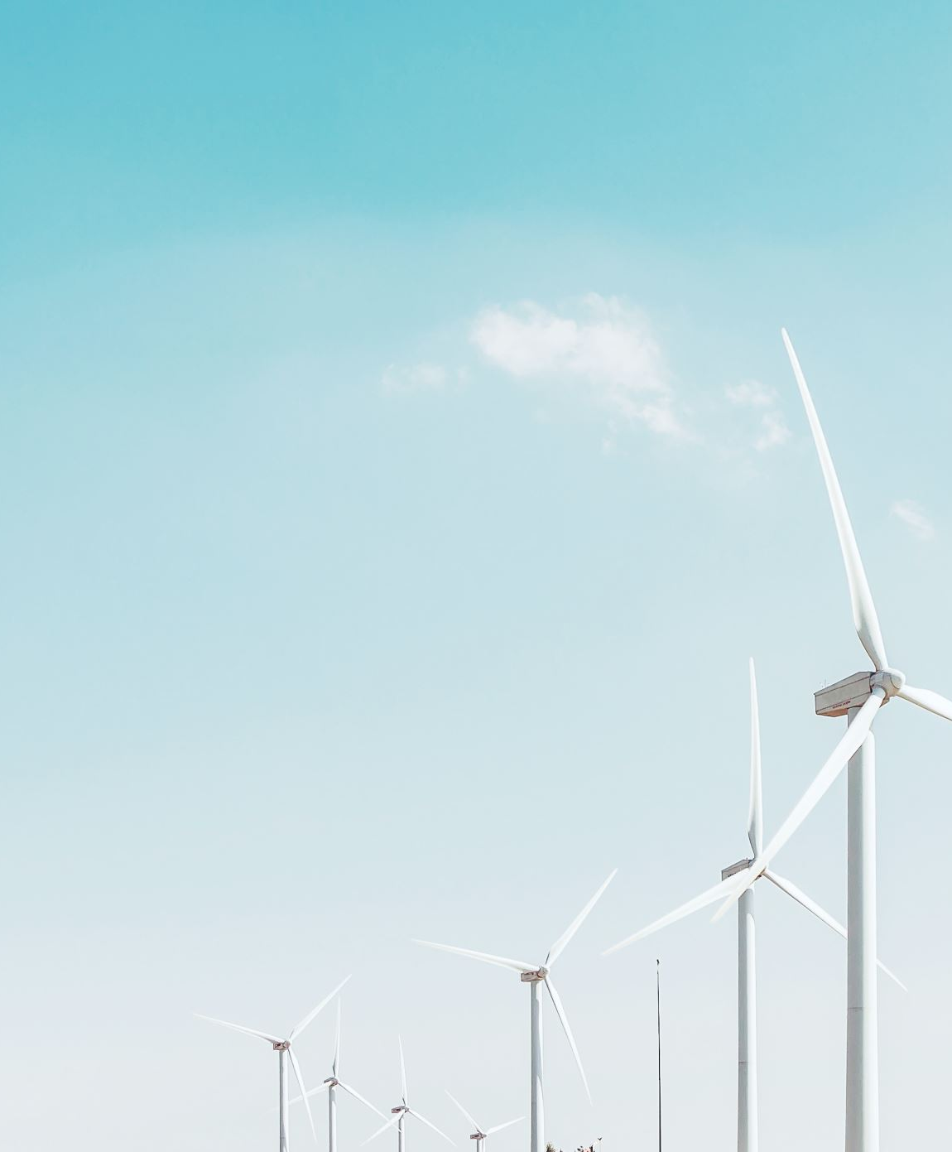
Introduction
EU Green Deal is a roadmap for sustainable growth and development in the European Union
Aims to make Europe the first climate-neutral continent by 2050
Launched in December 2019 by the European Commission
Designed to tackle climate change, biodiversity loss, and environmental pollution

Slide 4
Notes:
The Green Deal is an integral part of this Commission’s strategy to implement the United Nation’s 2030 Agenda and the sustainable development goals3, and the other priorities announced in President von der Leyen’s political guidelines4. As part of the Green Deal, the Commission will refocus the European Semester process of macroeconomic coordination to integrate the United Nations’ sustainable development goals, to put sustainability and the well-being of citizens at the centre of economic policy, and the sustainable development goals at the heart of the EU’s policymaking and action.

Slide 5
Key Objectives
Cut greenhouse gas emissions by at least 55% by 2030
clear vision of how to achieve climate neutrality by 2050
Transform the EU economy to be more sustainable
Shift to a circular economy that reduces waste and promotes recycling
Increase energy efficiency and boost renewable energy use
Protect and restore biodiversity and natural habitats

Slide 6
EU Green Deal parts
Designing a set of deeply transformative policies
Mainstreaming sustainability in all EU policies
THE EU AS A GLOBAL LEADER

Slide 7
Designing a set of deeply transformative policies
Increasing the EU’s climate ambition for 2030 and 2050
Supplying clean, affordable and secure energy
Mobilising industry for a clean and circular economy
Building and renovating in an energy and resource efficient way
Accelerating the shift to sustainable and smart mobility
From ‘Farm to Fork’: designing a fair, healthy and environmentally-friendly food system
Preserving and restoring ecosystems and biodiversity
Notes:
These policy reforms will help to ensure effective carbon pricing throughout the economy.
Carbon border adjustment mechanism, for selected sectors, to reduce the risk of carbon leakage. (EU CBAM)
Achieving a climate neutral and circular economy requires the full mobilisation of industry. It takes 25 years – a generation – to transform an industrial sector and all the value chains. To be ready in 2050, decisions and actions need to be taken in the next five years.
Energy-intensive industries, such as steel, chemicals and cement, are indispensable to Europe’s economy, as they supply several key value chains. The decarbonisation and modernisation of this sector is essential. The recommendations published by the High Level Group of energy-intensive industries show the industry’s commitment to these objectives15.
The circular economy action plan will include a ‘sustainable products’ policy to support the circular design of all products based on a common methodology and principles. It will prioritise reducing and reusing materials before recycling them. It will foster new business models and set minimum requirements to prevent environmentally harmful products from being placed on the EU market. Extended producer responsibility will also be strengthened.

Slide 8
Mainstreaming sustainability in all EU policies
Pursuing green finance and investment and ensuring a just transition
Greening national budgets and sending the right price signals
Mobilising research and fostering innovation
Activating education and training
A green oath: ‘do no harm’
Notes:
To achieve the ambition set by the European Green Deal, there are significant investment needs. The Commission has estimated that achieving the current 2030 climate and energy targets will require €260 billion of additional annual investment27, about 1.5% of 2018 GDP28. This flow of investment will need to be sustained over time. The magnitude of the investment challenge requires mobilising both the public and private sector.
The Commission will present a Sustainable Europe Investment Plan to help meet the additional funding needs. It will combine dedicated financing to support sustainable investments, and proposals for an improved enabling framework that is conducive to green investment. At the same time, it will be essential to prepare a pipeline of sustainable projects. Technical assistance and advisory services will help project promoters to identify and prepare projects and to access sources of finance.
At least 30% of the InvestEU Fund will contribute to fighting climate change.
National budgets play a key role in the transition. A greater use of green budgeting tools will help to redirect public investment, consumption and taxation to green priorities and away from harmful subsidies.
Well-designed tax reforms can boost economic growth and resilience to climate shocks and help contribute to a fairer society and to a just transition. They play a direct role by sending the right price signals and providing the right incentives for sustainable behaviour by producers, users and consumers.
New technologies, sustainable solutions and disruptive innovation are critical to achieve the objectives of the European Green Deal. To keep its competitive advantage in clean technologies, the EU needs to increase significantly the large-scale deployment and demonstration of new technologies across sectors and across the single market,
All EU actions and policies should pull together to help the EU achieve a successful and just transition towards a sustainable future.

Slide 9
Actions Taken
Proposing a European Climate Law to make the 2050 climate neutrality target legally binding
Investing in research and innovation to develop sustainable technologies
Implementing a Circular Economy Action Plan to reduce waste and promote sustainable consumption
Launching the Farm to Fork Strategy to ensure a fair, healthy and environmentally-friendly food system
Providing financial support to member states to facilitate the transition to a greener economy

Slide 10
Benefits
Create new jobs and business opportunities in sustainable sectors
Reduce pollution and improve air and water quality
Protect and restore natural habitats and biodiversity
Promote sustainable and healthy food systems
Enhance Europe's leadership role in the global fight against climate change

Slide 11
Challenges
Achieving the 55% emissions reduction target by 2030 will require significant efforts and investments
Balancing environmental and economic interests
Ensuring a just transition that supports affected communities and workers
Overcoming resistance from member states and industry sectors
Maintaining public support and engagement for the EU Green Deal agenda.

Slide 12
THE EU AS A GLOBAL LEADER
The EU will continue to promote and implement ambitious environment, climate and energy policies across the world.
The EU will continue to ensure that the Paris Agreement remains the indispensable multilateral framework for tackling climate change.
The EU will continue to ensure that the Paris Agreement remains the indispensable multilateral framework for tackling climate change.
Trade policy can support the EU’s ecological transition.
As the world’s largest single market, the EU can set standards that apply across global value chains.
Notes:
It serves as a platform to engage with trading partners on climate and environmental action. Commitments to sustainability have been continuously strengthened in EU trade agreements, in particular with regard to enhancing climate change action. The Commission has also been stepping up efforts to implement and enforce the sustainable development commitments of EU trade agreements, and these efforts will be further enhanced with the appointment of a Chief Trade Enforcement Officer. On climate change more specifically, the EU’s most recent agreements all include a binding commitment of the Parties to ratify and effectively implement the Paris Agreement. The Commission will propose to make the respect of the Paris agreement an essential element for all future comprehensive trade agreements. The EU’s trade policy facilitates trade and investment in green goods and services and promotes climate-friendly public procurement. Trade policy also needs to ensure undistorted, fair trade and investment in raw materials that the EU economy needs for the green transition. It can help address harmful practices such as illegal logging, enhance regulatory cooperation promote EU standards and remove non-tariff barriers in the renewable energy sector. All chemicals, materials, food and other products that are placed on the European market must fully comply with relevant EU regulations and standards. The EU should use its expertise in “green” regulation to encourage partners to design similar rules that are as ambitious as the EU’s rules, thus facilitating trade and enhancing environment protection and climate mitigation in these countries.

Slide 13
Siddi, Marco. "The European Green Deal: Assessing its current state and future implementation." (2020).

Slide 14
Policy priority
Maintaining priority in EU and national policy planning throughout the long period over which it will be implemented is the main overarching challenge for the Green Deal.
COVID-19 shifted the policy focus
*Russian war in Ukraine accelerated the energy transition

Slide 15
Financial endowment
The Commission has estimated that achieving the current 2030 climate and energy targets will require €260 billion in additional annual investment.
However, the actual need is much higher
Overall, based on the figures and estimates that the Commission has published and the broader economic context, financial prospects for the Green Deal are not encouraging.

Slide 16
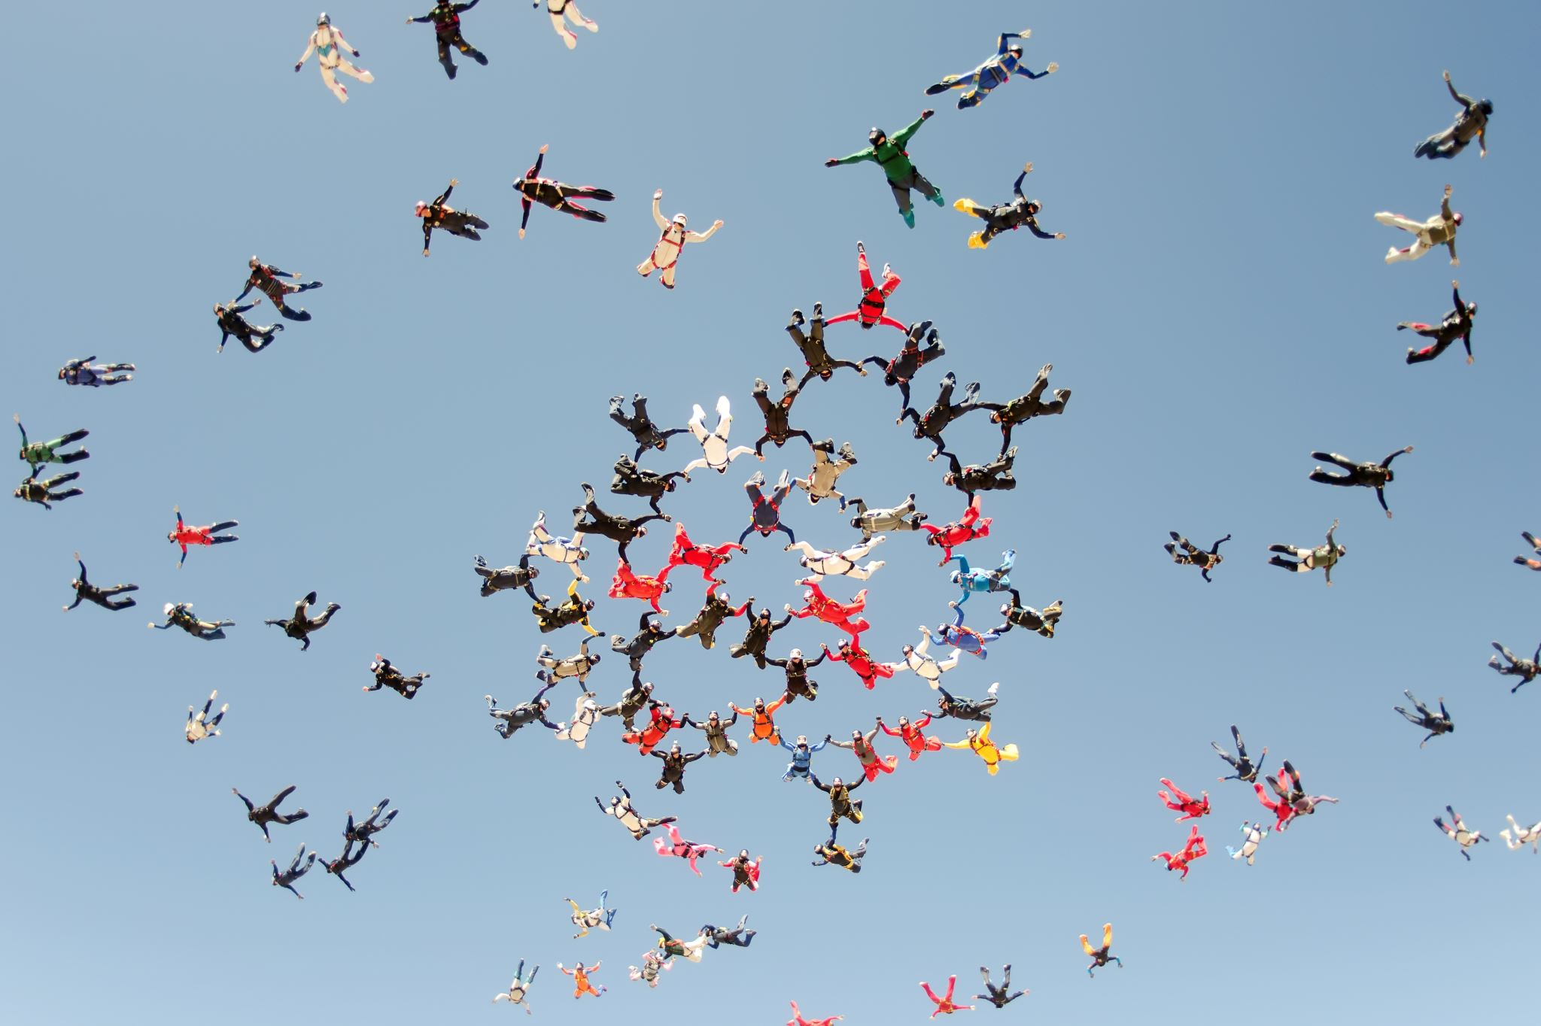
Competence of EU institutions
Most likely, member states will be reluctant to relinquish additional sovereignty on decisions that affect the structure of their energy supply and the speed and cost of the energy transition.
Based on past experience, some members will probably pursue more ambitious goals than those set at EU level, while others will be less ambitious – with potential variations within each member state based on the political priorities of successive national governments.
This suggests that the Commission’s proposal to use delegated acts in pursuit of climate neutrality will face strong resistance from an informal coalition of EU members that are sceptical of or oppose the 2050 target

Slide 17
International cooperation
Particular emphasis is put on supporting the ecological transition in the EU’s immediate neighbours, namely the Western Balkans, the Southern Neighbourhood and the Eastern Partnership countries.
While not explicitly mentioned in the Green Deal Communication, the success of global climate action will largely depend on policy coordination between the three largest GHG emitters – China, the United States and the EU
Coordination with third countries will also be important in the light of measures that will need to be introduced to ensure domestic functioning and to advance the objectives of the Green Deal.
Notes:
In concrete terms, the proposal to gear EU trade policy to support the ecological transition, including commitments to sustainability in EU trade agreements, is one of the most consequential measures.

Slide 18
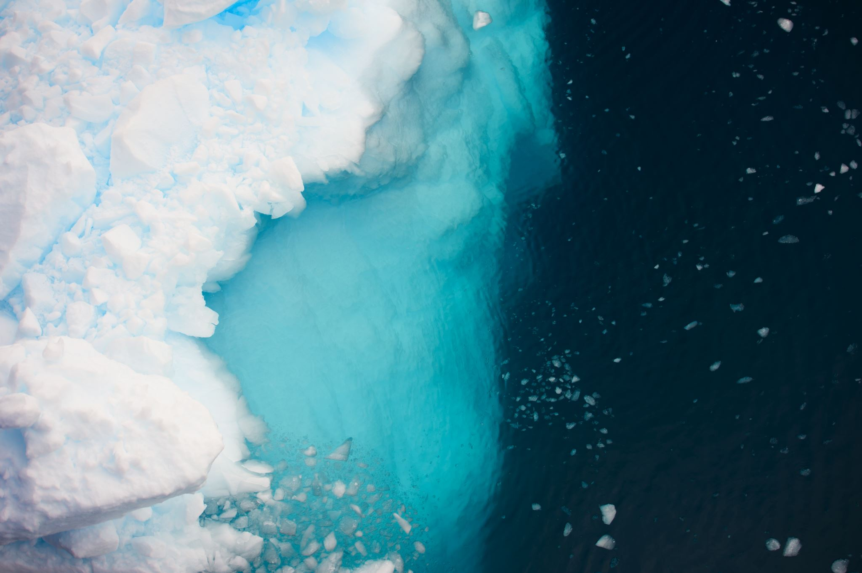
Conclusion
The European Commission is continuing to pursue climate action in a challenging international setting, amidst growing geopolitical tensions, the rise to power of climate change deniers in major emitters, a pandemic and the ensuing economic slowdown.
Most likely more financial resources will be required
It can also make a fundamental contribution to climate action through technology and financial transfers to countries of the Global South

Slide 19
Thank you! Question?
r.sabyrbekov@osce-academy.net

