Slide 1
Sectors: Energy
Rahat Sabyrbekov
OSCE Academy
Bishkek 2023

Slide 2
EU climate and energy governance in times of crisis: towards a new agenda, Journal of European Public Policy, 28:7, 959-979, DOI: 10.1080/13501763.2021.1918221
Ingmar von Homeyer, Sebastian Oberthür & Andrew J. Jordan (2021)

Slide 3
The evolution of EU climate governance
The EU has also developed an increasingly dense arsenal of policies covering nearly all relevant policy sub-sectors, such as buildings, transport, industry, power production, forests, renewables and energy efficiency.
Today, the policy instrument mix includes market (ETS and various funds supporting climate-friendly innovation and investments), regulatory (e.g., CO2 standards for cars, energy efficiency standards for products) and procedural elements (planning, reporting and review).

Slide 4
EU GHG emission reduction targets.

Slide 5
Five crisis trends
Growing socio-political divisions
Rising ‘post-factual’ forms of political communication
Growing legitimacy challenges
Increasing constraints on governance capacity
Wider geopolitical shifts
Notes:
An identity cleavage that started to cut across the long dominant left-right political cleavage has arguably accentuated socio-political divisions. Its rise can be traced back to several factors, including: the partial transfer of core state powers to the EU and ongoing globalisation (e.g., Genschel & Jachtenfuchs, 2018; Hooghe & Marks, 2018); generational value change and a backlash against cosmopolitan and liberal values (Norris & Inglehart,
2018); socio-economic transformations, particularly the shift towards a knowledge economy; and rising economic inequality, feeding fears of a loss of social status amongst the most heavily affected groups (Gidron & Hall, 2020).
Post-factual political communication refers to the politically motivated dissemination of ‘information’ which denies or ignores well-established facts and available evidence.
An increasing reliance on out-/throughput legitimacy at the expense of input legitimacy has arguably left many liberal democratic institutions acutely vulnerable to challenges. ‘Technical’ tasks have been placed under the authority of independent and international bodies (such as central banks and regulatory agencies), thereby weakening input legitimacy (Steffek, 2014).
The wider literature is replete with examples of how globalisation and technological advances have reduced the effectiveness of governance. Complex international value chains and the growing mobility of capital, facilitated
by active liberalisation, have resulted in greater international competition for inward investment and employment. As a result, individual governments’ capacity to pass effective regulation and autonomously determine taxes has arguably been more heavily constrained (Hale et al., 2013; Scharpf, 1997; see, however, Iversen & Soskice, 2019).
Finally, while an internationally dominant US initially guaranteed the liberal international order after the Cold War, global politics has since become more multipolar, with a pronounced re-emergence of great power competition and rising system competition between China and the US. China, Russia and India, among others, have emerged as great powers with significant and growing resources.

Slide 7
Key findings
Effects: strengthening of EU climate and energy governance
The contributions in fact suggest that EU climate and energy policy has advanced not only despite, but to some extent even because of the crisis trends (e.g., the emergence of a more supportive coalition in the EP in response to the rise of populist parties).
Driving forces: countervailing effects and responses
Interactions and feedback effects

Slide 8
Meyer-Ohlendorf, Nils; Matthias Duwe; Katharina Umpfenbach and Keighley McFarland 2014: The Next EU Climate and Energy Package – EU Climate Policies after 2020, Ecologic Institute, Berlin.

Slide 9
Introduction
This study discusses EU climate and energy policies for the decade after 2020: what should EU climate and energy policies look like between 2020 and 2030?
There are many possible answers to this question. They will differ depending on the context of those providing the answers, their interests and perception, political and economic circumstances, or assessment of technological innovation.
Regardless of these differences, any response must keep one thing in mind: climate and energy policies of the next decade must put the EU on a path of decarbonising its economies and societies.
Climate change makes decarbonisation indispensable; energy security, competiveness and innovation – to name a few aspects – are other key considerations.

Slide 10
Implementation and Progress of the Climate and Energy Package 2008
All economic sectors have reduced their emissions since 1990, except transport
Notes:
While energy supply and use (excluding transport), agriculture, industrial processes and waste have experienced a decline in emissions, transport emissions have increased between 1990
and 2010. In 2012, however, the main emission reductions occurred in the transport sector (EEA 2013c, 94). The largest reductions were achieved in manufacturing industries and
construction, industrial processes and the energy sector, while absolute reductions within the other sectors have been small since 1990 (Eurostat 2011b, 226). With around 80% of GHG
emissions in 2008, the energy system remains the single largest source of emissions in the EU: the energy sector itself accounts for 31% of all emissions, transport for 22%, industry for 11% and heating for housing for another 11%

Slide 11
Evaluation of EU policies: contributions of instruments and other factors
Many factors have contributed to these reductions.
EU climate and energy policy, increasing importance of the services sector, larger imports of consumer goods, warmer winters, economic crisis.
Climate and energy policy
Renewable energies resulting from introduction of national support schemes, triggered by EU RES support
Emission trading
Emission reductions in agriculture and waste

Slide 12
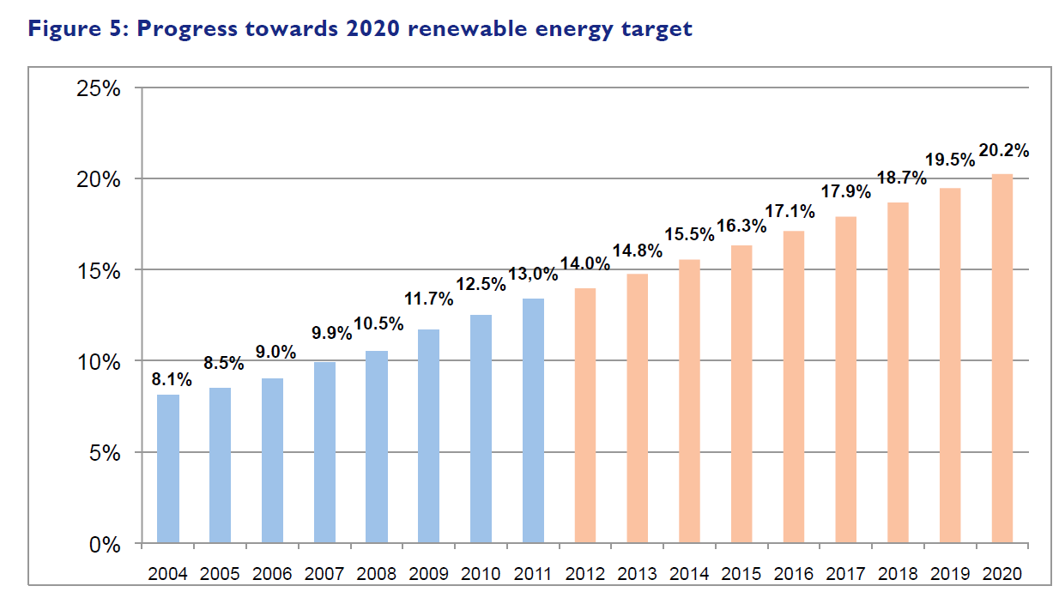
Target: Expanding renewable energy
Notes:
The 2009 Renewable Energy Directive7 (RED) updated this target: the EU committed itself to increase the share of renewable energies in gross final energy consumption8 to 20% by 2020 (European Parliament and European Commission 2009). According to the directive, all MS have to achieve a binding target of 10% renewable energy in final energy consumption in transport as well as individual targets for the total share of renewable in final energy consumption. The differentiated MS targets reflect differences in starting points, resource bases and capacity to invest. All MS developed national renewable energy action plans (NREAPs) in 2010 detailing how they were planning to achieve their target, including trajectories per sector and technology. Based on this planned development they have to report on their progress to the Commission every two years.

Slide 13
Evaluation of Instruments: Renewable Energy Directive
The Renewable Energy Directive sets a framework for renewable energy promotion by providing:
Mandatory targets;
Detailed planning and regular monitoring requirements for MS;
A common framework for sustainability certification of biofuels;
Rules on simplification of administrative procedures to be implemented by MS.

Slide 14
Renewable energy policy database and support

Slide 15
Target: Increasing Energy Efficiency
The EU aimed to improve energy efficiency by 20% by 2020.
There are also considerable differences between MS. Only four Member States (Bulgaria, Denmark, France and Germany) are making “good progress” in reducing energy consumption and primary energy intensity.
Current policies in most MS, however, are not sufficiently developed and / or implemented

Slide 16
Energy efficiency progress
Notes:
Between 1990 and 2016, the energy efficiency of end-use sectors improved by 30 % in the EU-28, at an annual average rate of 1.4 %/year, as measured according to the ODEX indicator

Slide 17
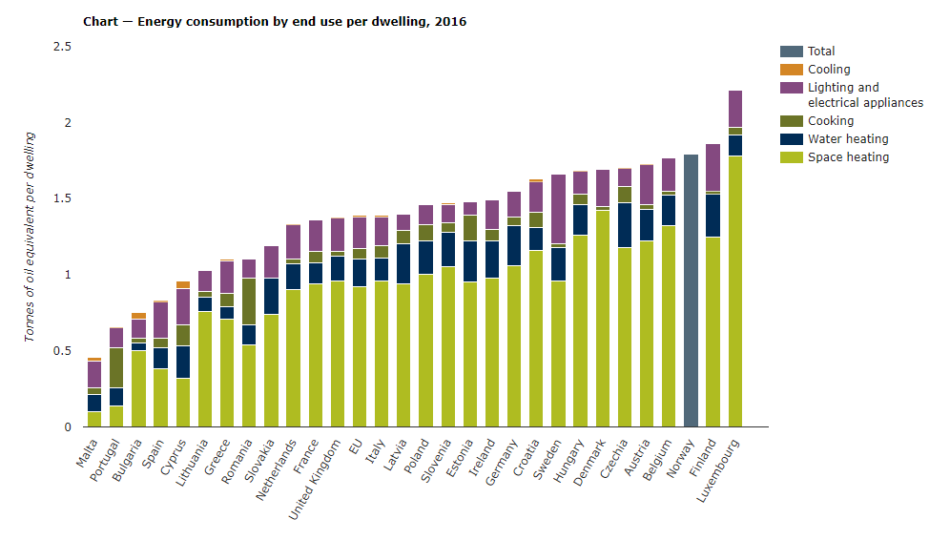

Slide 21
Notes:
Energy efficiency in industry has increased by 38 % in the EU-28 over the period 1990-2016, at an annual average rate of 1.8 %/year.
n the transport sector, energy efficiency increased by 20 % between 1990 and 2016 in the EU as a whole, at an annual average rate of 0.9 %/year.
https://www.eea.europa.eu/data-and-maps/indicators/progress-on-energy-efficiency-in-europe-3/assessment

Slide 22
Evaluation of instruments
Product Standards: The Ecodesign Directive (2009/125/EC)
Energy Performance Standards for Buildings (EPBD)
Efficiency Standards for Cars
Energy Taxation Directive
Energy Efficiency Directive

Slide 23
EU Climate and Energy Policies after 2020 – Targets and Instruments

Slide 24
EU Climate and Energy after 2020: Summary and Recommendations
Current policies substantially reduced GHG emissions
Stricter ETS and political ambition required
Energy efficiency in heating and transport is priority

Slide 25
Future of European Energy
https://www.youtube.com/watch?v=wwa4PTsm5fw

Slide 26
Review of 50 years of EU energy efficiency policies for buildings.
M. Economidou, V. Todeschi, P. Bertoldi, D. D’Agostino, P. Zangheri, L. Castellazzi, 2022

Slide 27
Introduction
Accounting for about 40% of EU’s final energy and 36% of CO2 emissions, buildings are associated with a significant untapped energy saving potential
Much of the energy currently used in buildings is wasted due to outdated construction practices, use of inefficient systems or appliances and lack of effective technical control systems.
Review of 50 years of the EE policies adopted by the EU and some of the policies adopted by its Member States (MSs) since the 1970s in order to improve the energy security and equity, reduce the impact on the environment, and increase the competitiveness of the European economy

Slide 28
EU energy efficiency of buildings has started in 1970s
Many of the energy efficiency measures can generate significant energy savings

Slide 29
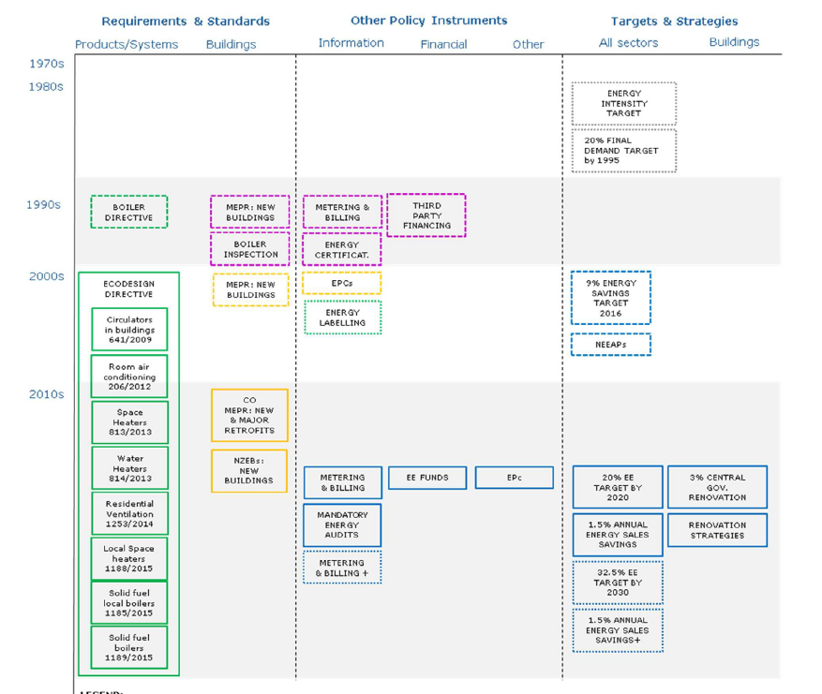

Slide 30
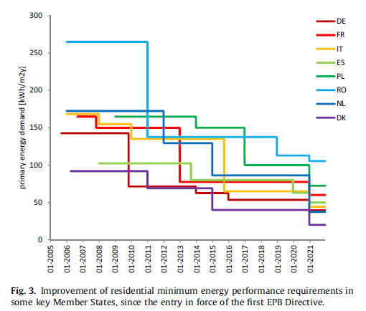
The national minimum energy performance requirements have evolved
A notable improvement for the countries, attained progressively over a relatively short period through reiterations of at least three legislative steps.

Slide 31
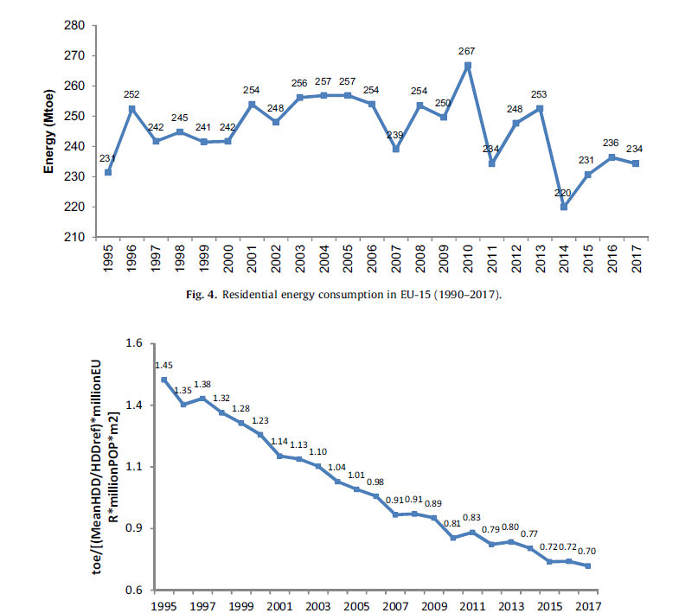

Slide 32
Conclusion (1)
The EU has adopted policies and programmes to promote general energy efficiency since the 1970s and since the 1980s focusing on buildings.
Important developments have also occurred in the diversification of instruments and tools deployed in energy efficiency policy, moving from policies solely comprising building codes up until the 1990s to comprehensive policy packages from the 2000s onwards.
The adoption of more stringent building standards and requirements for boilers has contributed to a decline in heating energy consumption, which is the major energy use in the building sector in the EU.
Notes:
While the SAVE Directive of the preceding decade included many thematic areas which are of key relevance even today (e.g. metering/ billing, energy certifications, third party financing, etc.), it was the legislative framework set out by the EPBD in 2002, ESD in 2006 and EED in 2012 which mandated the implementation of a wide range policy instruments at national level

Slide 33
Conclusion (2)
Buildings are increasingly expected to meet higher performance requirements, reaching a positive balance between the produced and required energy
The inclusion of climate change impact on buildings.
Solid financial component on energy efficiency has a key role in the transition towards climate-neutral buildings, with a need for more targeted financial mechanisms, new financial models and more active participation of financial institutions.

Slide 34
Demonstration of Smart Readiness Indicator
https://www.youtube.com/watch?v=GV6dY8rrn4w

Slide 35
Thank you! Questions?
r.sabyrbekov@osce-academy.net

