Slide 1
The importance of non-tariff barriers to trade in Central Asia
Jonathon Hornbrook, GIZ

Slide 2
Hypothesis:
Russia’s WTO membership won’t bring major changes to actual trade flows in CA, if it still takes weeks to get our goods across the border & our certificates/lab results are not recognized abroad.

Slide 3
WTO Policy
Countries have a right to protect certain sectors, but they should do it efficiently, transparently and fairly through tariffs.

Slide 4
In CA it’s the NTBs!
Tariffs in most of CA are 7.5 – 5.5%:
They are not the most serious barrier.
Fact stated clearly since 2005 but to little effect (CAREC)

Slide 5
EDB (trade) and TI-CPI put us in the lower quintile
$ , Time , Docs
Yes, it’s unfair the tendency is certain

Slide 6
We have a BIG problem!
“Customs clearance here in Tajikistan is really quite good, it only takes 3-4 days” (in Kz it can take a week!)

Slide 7
TBTs
Our goods are difficult to export because our certificates & lab results aren’t recognized abroad: “quality uncertain” → ↓$
(Kz shows slow progress in NQI modernisation. KR &TJ frustratingly little.)

Slide 8
What is the problem with NQI?
What should be the relationship between accreditation, certification & testing?
When should you apply a TR rather than a standard?

Slide 9
Political decision makers don’t understand the importance or technicalities of National Quality infrastructure.
& some may even have vested interests in the status quo???

Slide 10
The traditional compromise of trade management
Facilitation
Protection
BTW… all business people are potential crooks: 100% control

Slide 11
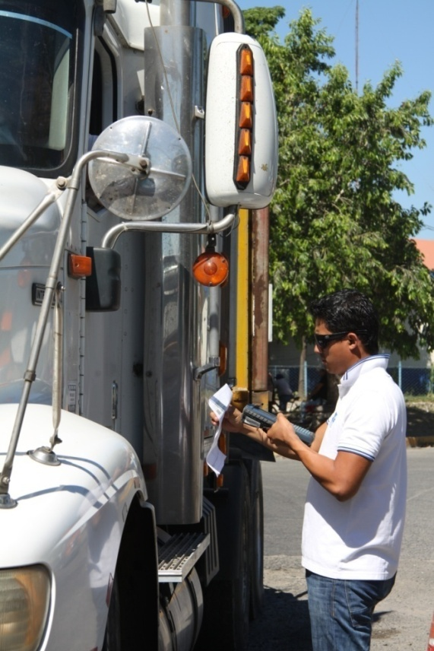
Change of mind set
“We have to serve the client better.”

Slide 12
Data based risk management
Security
Facilitation
“It won’t work here!”

Slide 13
Hypothesis:
Russia’s WTO membership won’t bring major changes to actual trade flows in CA, if it still takes weeks to get our goods across the border & our certificates/lab results are not recognized abroad.
…but Customs Union membership might.
…or will it simply formalize what already exists?

