Slide 1
Meeting of the Board of Trustees
Bishkek / Vienna (Zoom), 09.12.2020

Slide 2
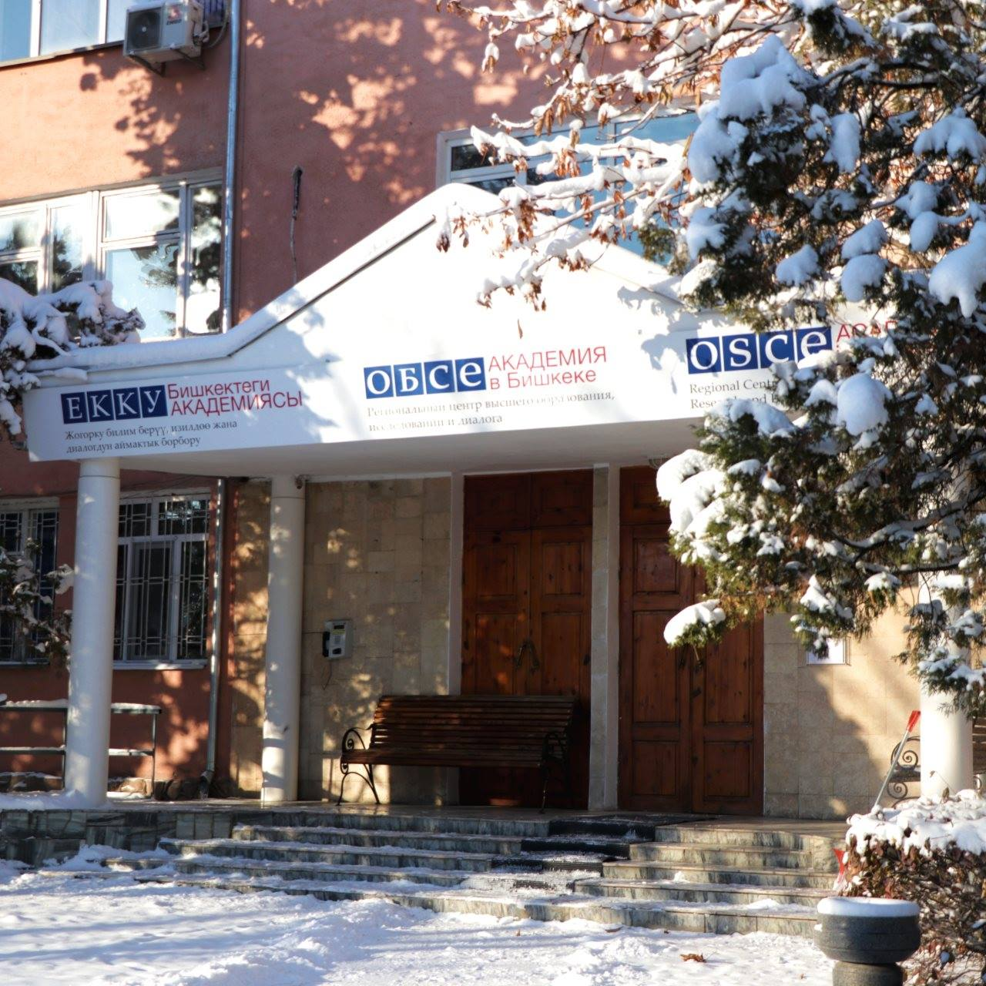
Table of Contents
Covid-19 response
Post-Graduate Education
Admission
Research & Dialogue Initiatives
International Cooperation & Partnerships
Appendix: Budget Report 2020 & Projection for 2021

Slide 3
Covid-19 Response
Orders of Ministry of Education and Sciences of the Kyrgyz Republic:
from 16.03.2020 and 24.03.2020 on distance-learning
from 19.03.2020 on faculty and admin management
Internships conducted online (partly)
Alumni Chapter meetings replaced by thematic online webinars for graduates
Conferences, Professional Trainings, Workshops, Guest Lectures conducted in Fall 2020 in online format
Summer School / Fall semester conducted online; plans to invite students from abroad to Bishkek early in 2021 to facilitate access to online education
Notes:
Alumni webinars: The art of storytelly for researchers, led by media expert and journalist from Kazakhstan Ms. Zarina Akhmatova on 15 June; "Preparing an Application and Preparing for Interviews with International Organizations" led by the OSCE Recruitment team – Mr. Gustavo Araujo, Chief Recruiter and Head of Talent Acquisition; Saltanat Tursungazieva and Pavel Nalimov, from Talent Acquisition Team on 24 June; planned "Interactive workshop on digital tools and challenges amid the global pandemic" led by Rashid Gabdulkhakov on 24 July.
3

Slide 4
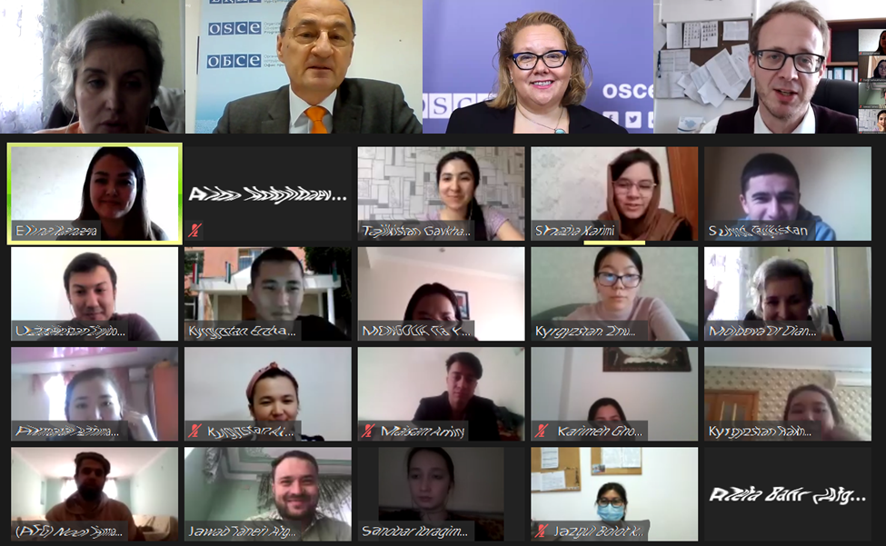
Post-Graduate Education (2020/2021)
Student Enrollment Statistics (November 2020):
Country | PS |  | EGD |  | Combined
 | Female | Male | Female | Male | Female | Male
Afghanistan | 2 | 3 | 3 | 5 | 5 | 8
Kazakhstan | 3 | 2 | 1 | 0 | 4 | 2
Kyrgyzstan | 3 | 4 | 6 | 2 | 9 | 6
Mongolia | 0 | 0 | 1 | 0 | 1 | 0
Tajikistan | 0 | 6 | 1 | 1 | 1 | 7
Turkmenistan | 0 | 1 | 0 | 0 | 0 | 1
Uzbekistan | 0 | 2 | 1 | 1 | 1 | 3
Out of region | 1 | 2 | 0 | 0 | 1 | 2
 | 9 (31%) | 20 (69%) | 13 (59%) | 9 (41%) | 22 (43%) | 29 (57%)
Total | 29 |  | 22 |  | 51
New in Fall Semester 2020: DAAD German Language Instructor

Slide 5
Post-Graduate Education (2019/2020)
Internship 2020:
* - including 4 students of class 2018-2019 (re-admitted in 2020 for thesis defense)
 | PS |  |  | EGD |  |  | Total
 | F | M | Total | F | M | Total | F | M | Total
International internships
OSCE Secretariat | 1 | 1 | 2 | 1 | 1 | 2 | 2 | 2 | 4
NUPI | 1 | 2 | 3 | 2 | 0 | 2 | 3 | 2 | 5
University of Catania, Italy | 0 | 2 | 2 | 0 | 0 | 0 | 0 | 2 | 2
Central Asia and Caucasus Research Group, USA | 0 | 0 | 0 | 0 | 1 | 1 | 0 | 1 | 1
KR Migration Service, Russia | 1 | 0 | 1 | 0 | 0 | 0 | 1 | 0 | 1
in the region | 3 | 15 | 18 | 4 | 6 | 10 | 7 | 21 | 28
Total | 6 | 20 | 26 | 7 | 8 | 15 | 13 | 28 | 41*
Format of the internship | PS | EGD | Total
Online | 11 | 5 | 16
Offline | 9 | 7 | 16
Mixed | 6 | 3 | 9
MA Thesis work schedule:
Activity | Dates
Submission of Thesis | 24 December 2020
Evaluation of Thesis | 25 Dec 2020 – 11 Jan 2021
Thesis defense | 13-15 January 2021

Slide 6
Post-Graduate Education (2021/2023)
Admission Statistics (from December 3, 2020; Deadline: December 20)
Country | PS |  |  | EGD |  |  | Total
 | Total | Female | Male | Total | Female | Male | Total submitted | Female | Male
Afghanistan | 157 | 29 | 128 | 211 | 22 | 189 | 368 | 51 | 317
Kyrgyzstan | 17 | 8 | 9 | 14 | 5 | 9 | 31 | 13 | 18
Kazakhstan | 2 | 1 | 1 | 1 | 1 | 0 | 3 | 2 | 1
Mongolia | 1 | 0 | 1 | 1 | 1 | 0 | 2 | 1 | 1
Tajikistan | 8 | 1 | 7 | 13 | 3 | 10 | 21 | 4 | 17
Turkmenistan | 1 | 0 | 1 | 3 | 1 | 2 | 4 | 1 | 3
Uzbekistan | 4 | 2 | 2 | 4 | 2 | 2 | 8 | 4 | 4
Out of region | 2 | 1 | 1 | 1 | 0 | 1 | 3 | 1 | 2
Total | 192 | 42 | 150 | 248 | 35 | 213 | 440 | 77 | 363

Slide 7
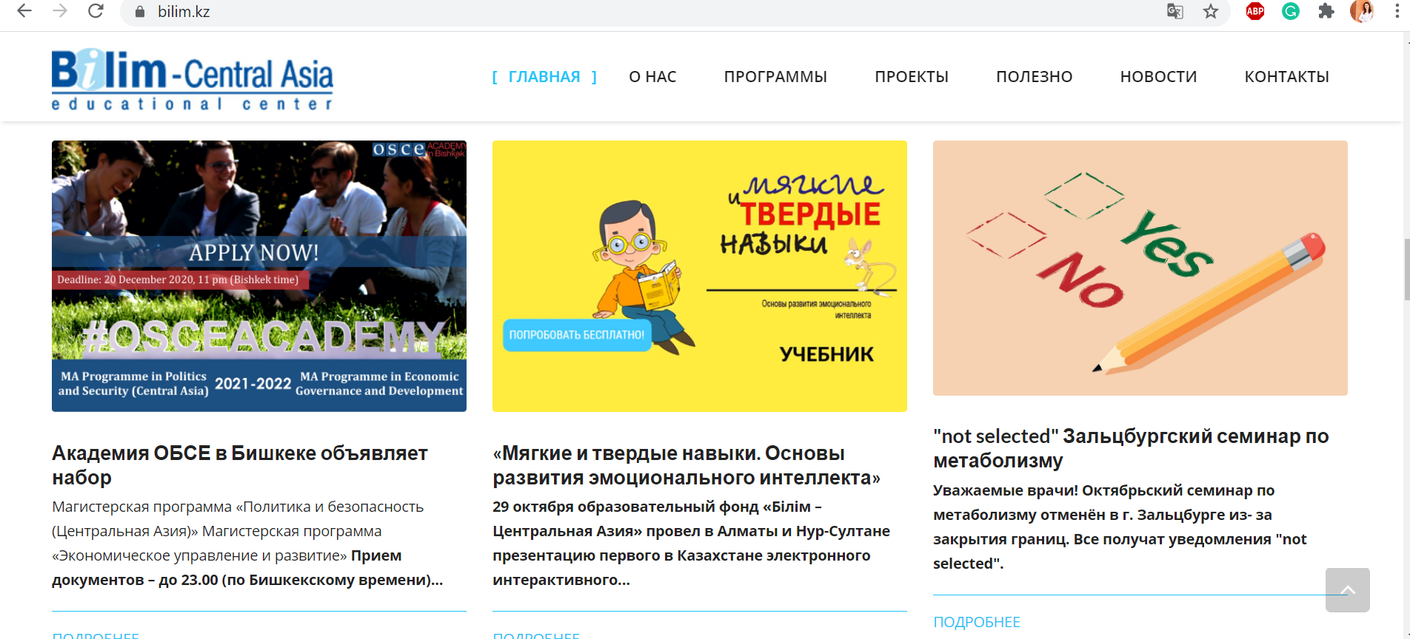
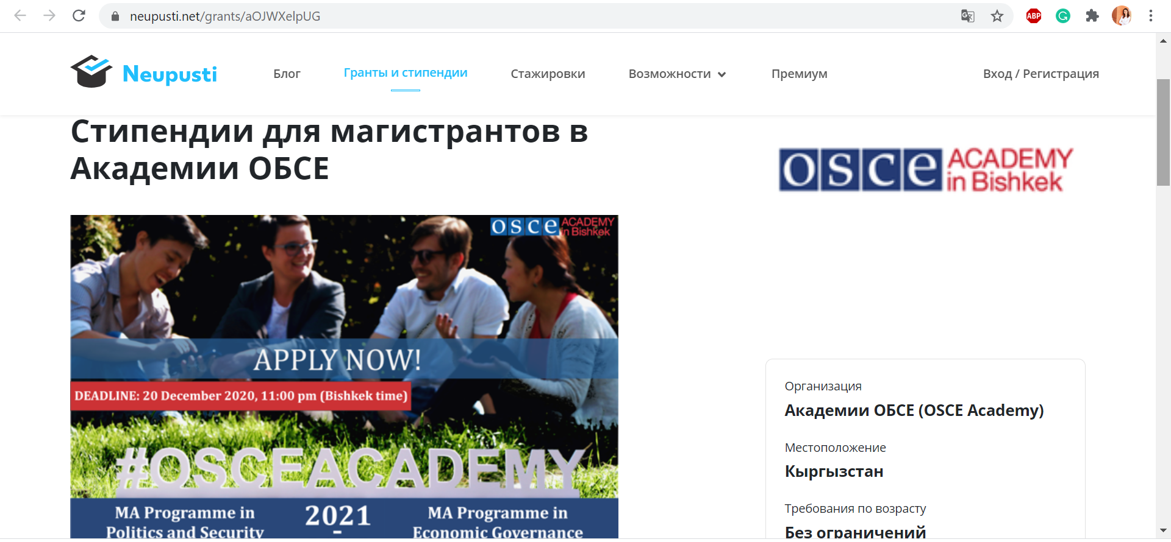
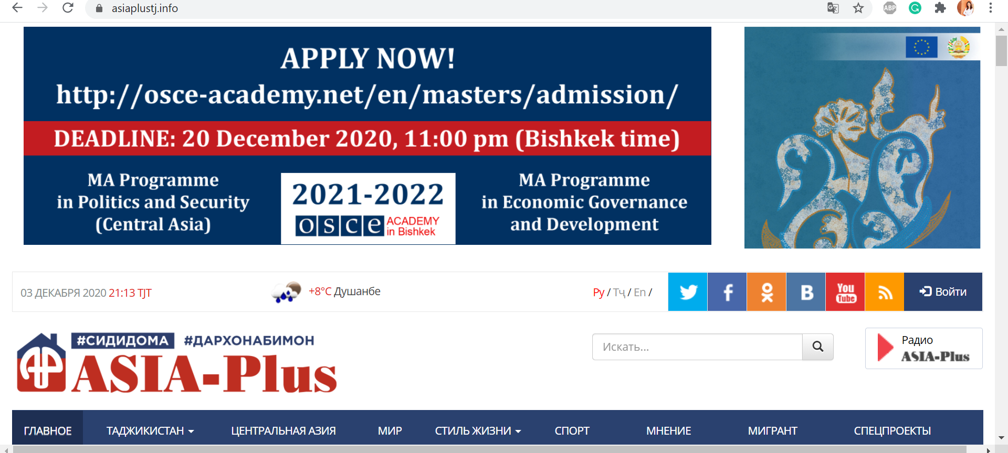
Post-Graduate Education (2021/2023)
Advertisement of the MA Scholarships
Free sources: Website, Alumni Network, Current Students, Mailing List (including Partner Universities), Newsletter, Twitter, LinkedIn, Virtual Open House
Paid Sources:
Facebook and Instagram covering all OSCE participating States and Afghanistan
Kazakhstan: Neupusti.net, Bilim.kz, Grants.kz
Tajikistan: Somon.tj, Asia Plus Radio, Asia Plus website
Uzbekistan: Uzjobs.uz, Kun.uz

Slide 8
Research and Dialogue – Research Projects
Current Research Projects:
Horizon 2020 Grant: AGRUMIG - “Leaving something behind” – Migration Governance and Agricultural Rural Change in “home” communities (project duration 2019 – 2021)
Outputs in 2020:
AGRUMIG Consortium Team published joint policy paper: ‘Between a Rock and a Hard Place: Early Experience of Migration Challenges under the COVID19 Pandemic’, Sept, 2020
AGRUMIG Kyrgyzstan team published a policy brief on COVID-19 and policy challenges in migration governance on Central Asia Program’s website, George Washington University, Dec, 2020
2 policy briefs on impact of COVID-19 on migration policy in KG are currently being drafted
Danish Institute for International Studies – OSCE Academy Research Partnership:
10 authors have been selected to write 10 policy briefs on the impact of COVID-19 crisis on Central Asia. Papers will be complied into a Special Issue to be published by the Academy in spring 2021.

Slide 9
Research and Dialogue – Research Projects
Research Grant Applications in 2020:
Horizon 2020: HYDROSTAN - Hydropower in Central Asia: Demonstrating Innovative and Sustainable Solutions for Unexplored Small-scale Applications; in partnership with Trinity College Dublin; Academy planned, main implementing partner for WP8 (policy dialogue); grant amount: EUR 11,750,062. Result: 2nd place
NED Small Grants Programme: Journalism Training (Kyrgyz language) at the Academy; submitted in March 2020; grant amount: USD 50,000. Result: Waiting
The Canada Grant for Local Initiatives: Research project planned on education; submitted in June 2020; grant amount: CAN 25,000. Result: Refused
OSCE Transnational Threats Department (TNTD) and the Office of the Co-ordinator of OSCE Economic and Environmental Activities (OCEEA): Enhancing youth crime prevention through education on legality and awareness campaigns addressing threats of organized crime and corruption, duration: 3 years; ExB project: EUR 2,500,000. Result: Waiting
UK Embassy Grant: Raising awareness and identifying knowledge gaps of climate change impact on Kyrgyzstan’s economy; submitted in November. £10,000. Result: Waiting

Slide 10
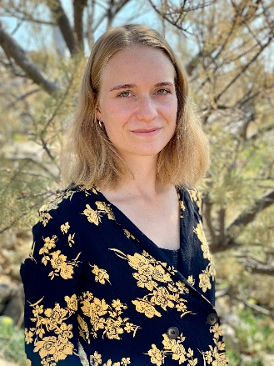
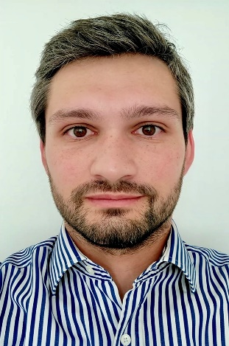
Research and Dialogue – Research Fellows
New Associate Research Fellows:
Nargiza Muratalieva, PhD, Kyrgyz Russian Slavic University
Research Topic: The Impact of Geopolitical
Projects in Central Asia
Barbara Roggeveen, PhD Candidate, University of Oxford.
Research Topic: Civilizational Discourses in
Contemporary Russian Foreign Policy
Elizabeth Militz, PhD, University of Bern.
Research Topic: A Digital Geography of Marginalized
Sexualities in Kyrgyzstan
Kinga Szalkai, PhD, Eötvös Loránd University, Budapest, Hungary.
Research Topic: Calming Down the Troubled Waters of Central Asia?
The Local and Regional Impacts of Mirziyoyev’s Political Turn Concerning Water Relations
Lambert Michael Eric, PhD, Sorbonne University.
Research Topic: The US Central Intelligence Agency (CIA)
Declassified Documents on Central Asia

Slide 11
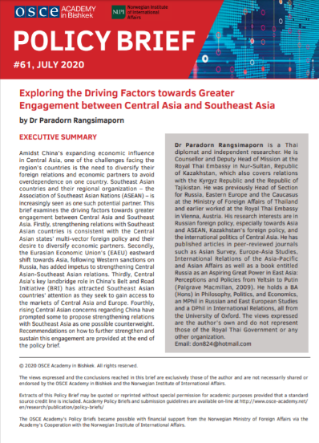
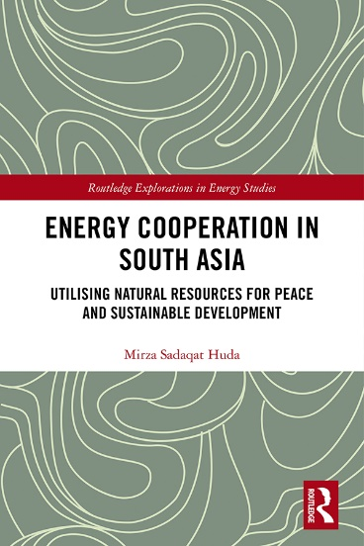
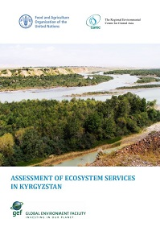
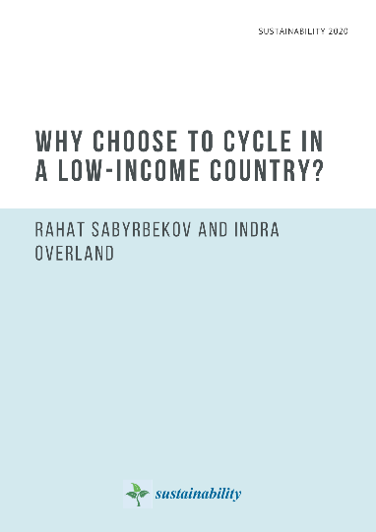
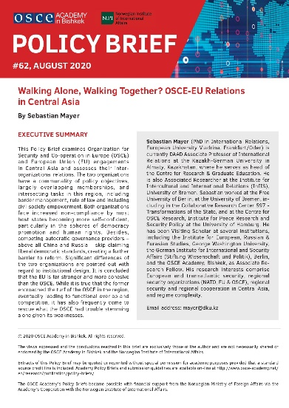
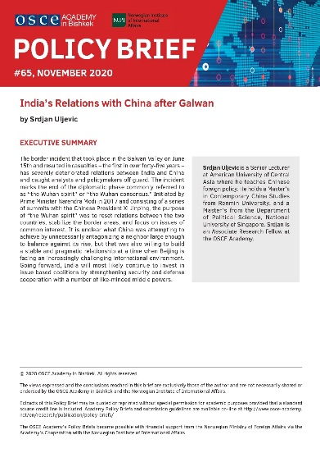
Research and Dialogue – Publications
Mid-December 2020: Alumni Magazine SalamAlum
July-December 2020: Policy Briefs #61 - #65
Research Fellows Publications in 2020:
“Energy Cooperation in South Asia, Utilizing Natural Resources for Peace and Sustainable Development”, by
Dr. Mirza Sadaqat Huda, Postdoctoral Research Fellow
“Assessment of Ecosystem Services in Kyrgyzstan” FAO of the United Nations and The Regional Environmental Centre for Central Asia, by Dr. Rahat Sabyrbekov, Postdoctoral Research Fellow
"Why choose to cycle in a low-income country?” by Dr. Rahat Sabyrbekov and Dr. Indra Overland, Sustainability 2020, 12(18), 7775

Slide 12
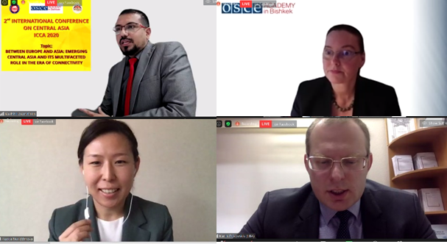
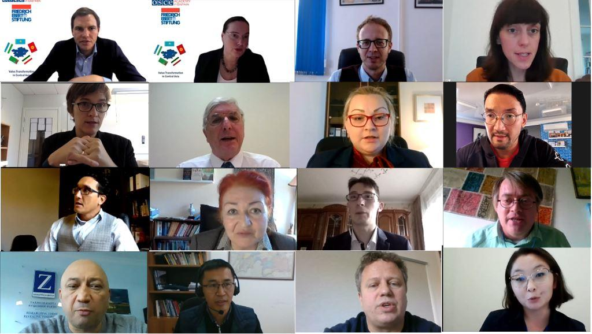
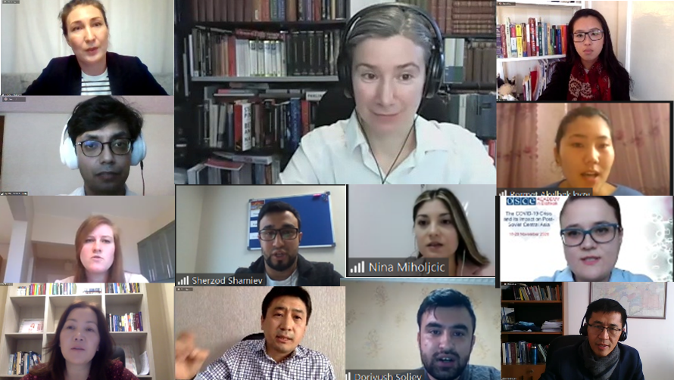
Research and Dialogue – Conferences
2-3 October: 2nd International Conference on Central Asia (ICCA) 2020, co-organized with the Silk Road Analytical and Research Center of the Ala-Too University
16-17 October: Interdisciplinary Conference on “Value Transformation in Central Asia” co- organized with Friedrich Ebert Foundation
18-20 November: Virtual Alumni/Expert Conference “The COVID-19 Crisis and its Impact on Post- Soviet Central Asia”

Slide 13
Professional Training
23 November - 3 December:
1st Project Management Training, within the framework of cooperation with Latvian National Project Management Association (LNPMA)
16 participants from Afghanistan, Kazakhstan, Kyrgyzstan, Tajikistan, and Uzbekistan
5 participants received grants for Official Certification (IPMA D Level) held on 3 December
7-11 December:
International Certificate Training Seminar on Human Right in an International Context

Slide 14
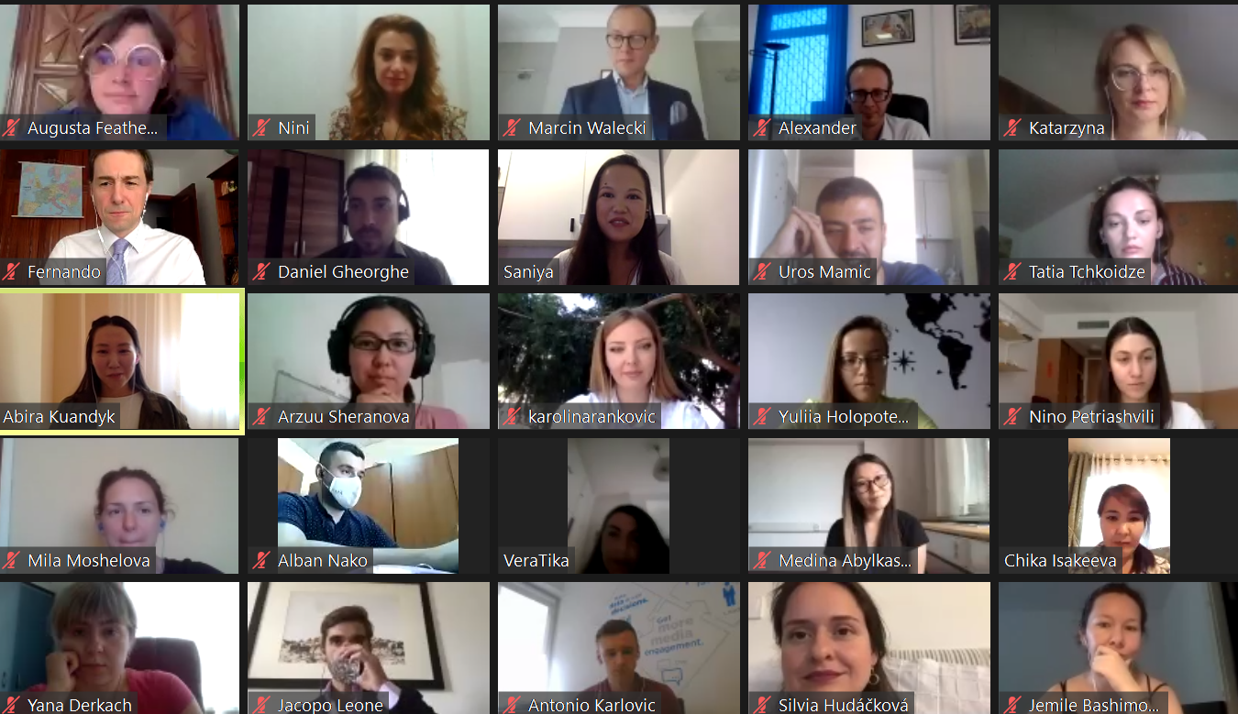
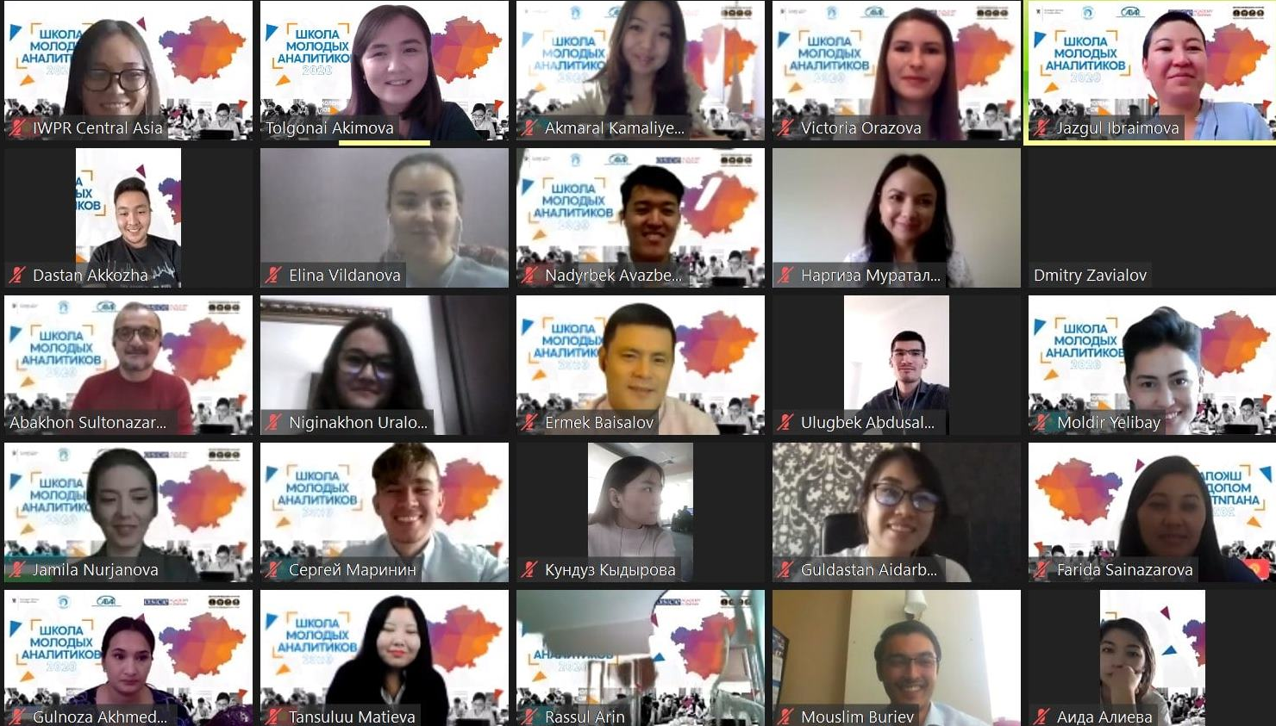
International Cooperation & Partnerships
Joint Events:
17-23 August: Third ECPR-OSCE/ODIHR Summer School on Political Parties and Democracy For researchers, practitioners, and civil society leaders from Albania, Bulgaria, Croatia, Czechia, Georgia, Kazakhstan, Kyrgyzstan, Poland, Romania, Russia, Serbia, Slovakia, Tajikistan, Turkmenistan and Ukraine
21-26 September: Third School for Young Analytics Cabar.asia For young researchers from Kazakhstan, Kyrgyzstan, Tajikistan, and Uzbekistan; to improve skills in policy analysis on topics related to development in Central Asia
Notes:
OSCE PA, currently alumna of 2016 Anastasia Griadasova is undergoing a Research Fellowship under this Agreement. It is planned that two more alumni will receive a chance to participate in the Research Fellowship.
University of Catania, instructor Dr. Daniella Irrera taught Political Violence and Terrorism module to PS students
OACC The OSCE Academy is already included into a Project Proposal project “Central Asia Monitor (CAMON): Analisi e Monitoraggio Stampa sulle dinamiche di sicurezza, politico-economiche e socio-culturali dell'Heartland” submitted by OACC to Italian MFA.
Kozminski University Erasmus Application 2020 and lecturer Dr. Lukasz Gruszczynski teaches International and Regional Trade Arrangements.
14

Slide 15
International Cooperation & Partnerships
* OSCE Academy now included into the World Higher Education Database (WHED) portal. In collaboration with UNESCO, the IAU WHED Portal is the global reference tool for higher education systems, credentials and institutions (HEIs).
New Partnerships:
Central Asian Barometer, Kyrgyzstan
Steinbeis Institute for International Business Studies, Germany
Latvian National Project Management Association
In process:
Prolonging the Agreement on Internships (JPO) with the Ministry of Foreign Affairs of Kazakhstan
Open Society Foundation, Kazakhstan
Central Asia Program at the Elliott School of International Affairs, The George Washington University, USA
ECOBAS (Economics and Business Administration for Society), University of Vigo, Spain

Slide 16
International Cooperation:
In November the OSCE Academy signed two Erasmus+ Inter-Institutional Agreements under the Key Action 1 – Mobility for learners and staff – Higher Education Student and Staff Mobility with:
Albert-Ludwigs-Universität Freiburg, Germany
Philipps-Universität Marburg, Germany
Waiting for results from:
University of Lodz (Poland)
Riga Graduate School of Law (Latvia)
University of Bamberg (Germany)
University of Macedonia (Greece)

Slide 17
Budget Projections
2020 | UB | ExB | NOR MFA / NUPI | EU / Horizon2020 | Total:
Budget Planned | 480,000 € | 672,647 € | 533,322 € | 10,784 € | 1,696,753 €
Budget Revision | 480,000 € | 471,064 € | 533,322 € | 13,193 € | 1,465,927 €
Budget Available | 480,000 € | 439,412 € | 533,322 € | 13,193 € | 1,465,927 €
Budget Expenditures | 476,924 € | 345,228€ | 293,280 € | - € | 1,115,432€
2021 | UB | ExB | NOR MFA / NUPI | EU / Horizon2020 | Total:
Budget Planned | 480,000 € | 534,674 € | 553,231 € | 15,000 € | 1,582,905 €
Budget Available | 480,000 € | 534,674 € | 553,231 € | 15,000 € | 1,582,905 €

