Slide 1
Presentation to the Board of Trustees Vienna , 1 November 2017
OSCE Academy in Bishkek

Slide 2
Current Financial Situation – Y/2017
Funding Gap for year 2017 closed:
Funding from NUPI disbursed end of July 2017
Generous ExB pledges from the AUS, GER, and US in Spring and Summer
Third-Party Funding from Switzerland (second tranche) in June 2017
Funding allowed resuming full scope of activities in Fall 2017

Slide 3
Past Cost Reduction and Contingency Plans
Reducing the numbers of students for the Academic Year 2017 / 2018
Suspension of Professional Trainings & Alumni Network events
Creation of co-financing models to support international internships; suspension of international internships
Reducing running costs by cutting staff and GSC

Slide 4
Emergency Measures Implemented by Fall 2017
Reduction of staff costs: implementation completed by 1 July (staff cost reduction of ~ EUR 48.000 in 2018 compared to 2017)
Reduction of overhead costs: savings scheme implemented, optimization ongoing
Central Asia School for Contemporary Journalism reduced to 3 weeks (one module taught instead of 3)
Close cooperation with POiB to cover renovation works (roof, sanitary systems) to be completed by 31 December 2017
New internship opportunities created in Central Asia (POiB, POiD took Interns) and with new partners in Europe

Slide 5
Activities implemented during Fall 2017
International Internships at NUPI (4), OSCE Secretariat (5), Aleksanteri Institute (NEW) (1)
Admission of new cohort of students to both MA programmes
24 students in MA EG&D | 23 students in MA P&S
563 appl in MA EG&D | 480 appl in MA P&S
(Old Class: 25 students in MA EG&D | 29 students in MA P&S)
Professional Trainings:
CASCJ (July 31 – August 18)
Regulatory Impact Analysis (September 11-15)
Feasibility Studies for Investment Projects (October 2-6)
Policy Paper Writing Seminar (November 6-10)
Certificate Programme on HR (November 21 – December 1)

Slide 6
Activities implemented during Fall 2017
Alumni Network Events
Alumni Chapter Meetings in Tajikistan, Kyrgyzstan, Kazakhstan
Annual Alumni Conference (scheduled for 18-19 November)
Summer Schools, Trainings, Workshops:
Contested Global Governance, Transformed Global Governors?
(Paris University 13, IFEAC, ANR | 3-4 July)
Strengthening Parliamentary Oversight in Kyrgyzstan
(Centre for European Security Studies | 28-30 August)
Regional Cooperation: Approaches from Central Asia & Europe
(TU Dortmund University, Volkswagen Stiftung | 21-23 September)

Slide 7
Reform of Budget & Operating Plan
Introducing new Cost Categories to better reflect Academy’s operating realities
Following OIO recommendations development of new budgeting templates to increase efficiency and transparency of financial processes
Including maintenance costs and contingency funding to render Academy’s operating plan more sustainable

Slide 8
Budget Plan | 2018
 | Cost Total / 2018 | Funding TOTAL | FS - UB | FS - ExB | FS - NUPI | FS - Erasmus+ | FS - SWISS | OTHER / TPF
Direct Student Funding | 368,382.00 € | 367,350.00 € | € | 182,562.00 € | 134,788.00 € | 15,000.00 € | 35,000.00 € | €
Ind Student Sup | 65,816.00 € | 65,641.00 € | 9,000.00 € | 41,166.00 € | 15,475.00 € | € | € | €
Acad & Edu Sup | 345,289.00 € | 345,370.00 € | 30,000.00 € | 161,090.00 € | 119,280.00 € | 10,000.00 € |  | 25,000.00 €
Prof Trainings | 136,003.00 € | 134,592.00 € | € | € | 86,592.00 € | € | € | 48,000.00 €
Research & Dialogue | 28,895.00 € | 28,000.00 € | € | € | 20,000.00 € | € | € | 8000 €
Alumni | 27,437.00 € | 27,808.00 € | € | 8,733.00 € | 19,075.00 € | € | € | €
GSC | 82,048.60 € | 87,055.00 € | 66,000.00 € | 16,720.00 € | 4,335.00 € | € | € | €
Staff | 287,406.00 € | 297,441.00 € | 211,000.00 € | € | 86,441.00 € | € | € | €
Total / Donor: |  |  | 316,000.00 € | 410,271.00 € | 485,986.00 € | 25,000.00 € | 35,000.00 € | 81,000.00 €
Total Year: | 1,341,276.60 € | 1,353,257 €

Slide 9
Budget Plan | 2018 – Set-Up & Rationale
SET-UP
Budget includes funding from Third Parties like Erasmus+ and DAAD
Professional Trainings appear with full costs
Increased costs for Audit factored in
Salary of Director is accounted for
Funding for a new project to establish permanent faculty positions included into the budget plan
RATIONALE
The budget plan allows flexible risk management by including contingency costs
It supports the Academy’s plan to strengthen research capacity
It operates with the assumption to increase student support in Fall 2018

Slide 10
Innovations introduced into 2018 Operating Plan (Selection)
Unified Stipend for all Students
Multiannual Full-Time Faculty Members
NUPI, ExB, TP Funding sought to create full-time positions for regional scholars to increase academic and research capacity
Establishment of pool of associated scholars as capacity measure for selection and supervision processes
Peer-reviewed Publications addressing regional audience (Russian language)
Policy Briefs published in English & Russian; Academic Yearbook in Russian
New Format of Associated Research Fellows to increase use of Academy’s academic infrastructure and academic and intellectual outreach
ARF to use library and access to data-base, to present findings and publish with OSCE Academy

Slide 11
New Vision for the OSCE Academy
Long-Term DAAD Visiting Professor (Application submitted)
Erasmus+ Credit Mobility to support Student and Faculty Exchange as well as international student internships (Application prepared | Funding for Fall 2018)
Erasmus+ “Capacity Building” to introduce PhD programme in the Social Sciences (Application prepared together with AUCA and UCA)
Visiting Chair in Political Sciences / Development Studies in Fall semester 2018
Two Regional Fellowship Scholars to start as full-time faculty in May 2018
New Academic outlets (Academy Yearbook, Working Paper Series) in Russian to increase regional visibility and to produce policy-relevant expertise
Expanding scope of educational outreach to include core region of Eurasia (Mongolia; Tatarstan, Bashkortostan, Ural Region (Russia))
Creation of Centre for Regional Security Studies

Slide 12
ExB Project 2018-2020
 | 2018 | 2019 | 2020 | Total | Contingency | Total + Contingency
Direct student funding | 182,562.00 € | 181,060.00 € | 318,000.00 € | 681,622.00 € | 34,081.10 € | 715,703.10 € | 715,703.10 €
Ensuring meritbased practices and transparency | 41,166.00 € | 41,166.00 € | 41,166.00 € | 123,498.00 € | 6,174.90 € | 129,672.90 € | 129,672.90 €
Academics & educational support | 161,090.00 € | 300,639.00 € | 288,518.00 € | 750,247.00 € | 37,512.35 € | 787,759.35 € | 787,759.35 €
Alumni | 8,733.00 € | 9,130.00 € | 19,103.00 € | 36,966.00 € | 1,848.30 € | 38,814.30 € | 38,814.30 €
Total YEAR: | 393,551.00 € | 531,995.00 € | 666,787.00 € | 1,592,333.00 € | 79,616.65 € | #VALUE! | 1,671,949.65 €
Total 2018-2020:
External Audit cost 3% of the overall budget |  |  |  |  |  | Ex | 50,159.00 €
Total 2018-2020: |  |  |  |  |  |  | 1,722,108.65 €

Slide 13
ExB Project 2018-2020 | Strategy
Increase yearly intake to 30+ students per MA programme
Multiannual full-time faculty positions to support the development and launch of research activities at the Academy, new educational partnerships, and academic training programmes
Regular academic and research-focused gatherings with increased output and wider outreach to interested audiences across Eurasia
Enhancing accountability and transparency in all operations of the Academy

Slide 14
License and Accreditation
MA in Politics & Security
Application for renewed license under way (old valid until 2/2018)
Re-Accreditation process to start in Spring 2018 (old valid until 9/2018)
New license will be valid for unlimited period
MA in Economic Governance & Development
License received in 2016 – valid for unlimited period
Accreditation for unlimited period successfully concluded in July 2017
European Credit Transfer System
System to be implemented at Academy by 12/2017 (Diploma Supplement)
International accreditation of programmes planned for 2019 upon availability of funding via Erasmus+

Slide 15
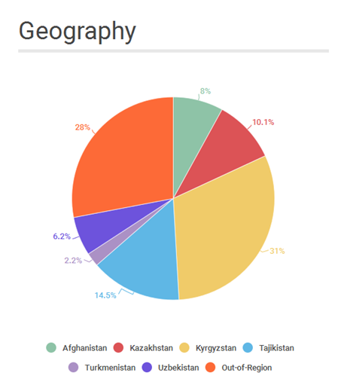
Alumni Network

Slide 16
Alumni Success | 1

Slide 17
Alumni Success | 2

Slide 18
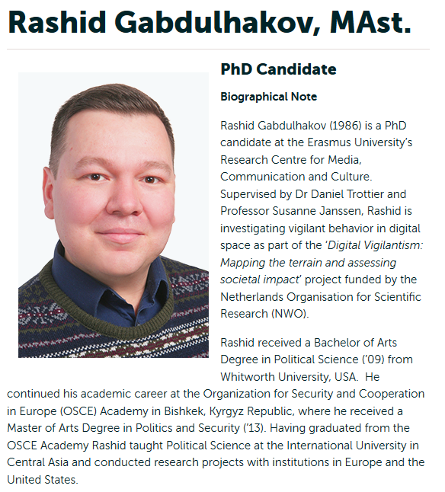
Alumni Success | 3

Slide 19
Alumni | Professional Career Development
Junior Public Officers Programme
In Afghanistan | MFA – Institute of Diplomacy
In Kazakhstan | MFA
In Kyrgyzstan | MoE - Investment Promotion Agency
NB: Aspiration to expand this JPO programme
NEW Research Fellowship at the International Secretariat of the OSCE Parliamentary Assembly in Copenhagen (Sergey Marinin | PS ’14, is first graduate enrolled in the programme)

Slide 20
Thank you very much for your attention & support!
The end

