Slide 1
Instruments: Environmental Taxation
Rahat Sabyrbekov
OSCE Academy
Bishkek, 2023

Slide 2
An environmental tax is a tax whose tax base is a physical unit (or a proxy of it) of something that has a proven, specific negative impact on the environment and which is defined in the European System of Accounts (ESA 2010) as a tax.
Notes:
The EU raised €325.8 billion from environmental taxes in 2021.
Energy taxes represented more than three-quarters of EU environmental tax revenue in 2021.

Slide 3
In 2021, EU environmental tax revenue amounted to €325.8 billion, accounting for 5.4 % of total government revenue from taxes and social contributions (TSC)

Slide 4
Environmental tax composition
Environmental tax revenue is broken down into four main categories: (i) energy taxes, (ii) transport taxes, (iii) pollution taxes and (iv) resource taxes.
Energy taxes include taxes on energy products (e.g. coal, oil products, natural gas and electricity) used for both stationary purposes and transport purposes. In 2021, the vast majority of environmental tax revenue (78.4 %) came from energy taxes.
Transport taxes mainly include taxes related to the ownership and use of motor vehicles. In 2021, transport taxes were the second largest source of environmental tax revenue in the EU, accounting for 18.1 % of the total.

Slide 5
Who pays environmental taxes?

Slide 7
Environmental taxes by payer
Notes:
n the EU, corporations paid 52 % of all energy tax revenue collected by governments in 2020. The contribution of households was around 4 pp lower (48 %).
Among the EU Member States, Luxembourg stands out with the largest share of the energy tax revenue (53 %) collected from non-residents, largely due to non-resident purchases of petrol and diesel. In Malta, this share is also substantial (35 %).
In 2020, households paid around 60 % or more of total energy taxes in Slovenia and Denmark (see Figure 12).
The services sector (including transportation and trade) accounted for 26 % of the EU energy tax revenue, with Slovakia and Croatia recording shares of over 40 %. Outside the EU, in Türkiye, the service sector is paying circa 60 % of energy taxes.
Manufacturing, construction, mining and utilities generated 23 % of the EU energy tax revenue.

Slide 8
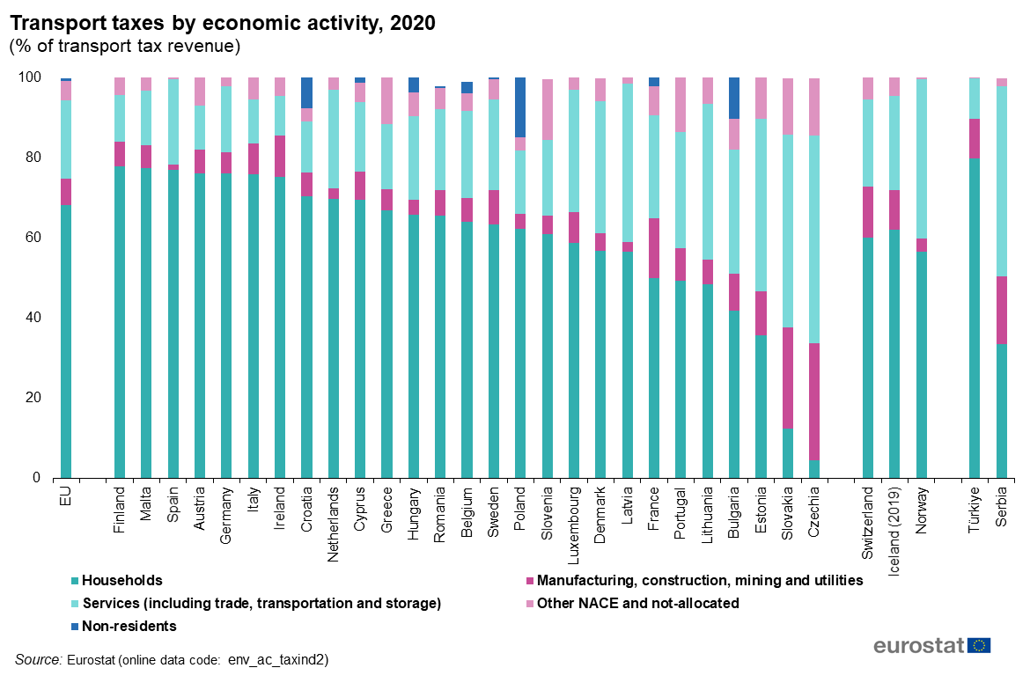

Slide 9
Environmental taxation in Europe: What does it depend on?
Concetta Castiglione, Davide Infante, Maria Teresa Minervini & Janna Smirnova

Slide 10
Environmental tax advantages and disadvantages
Environmental Tax Reform proposed by the European Environment Agency (2005): The aim of the reform is to shift the burden of taxation from “goods” (such as capital and labour) to “bads” (such as polluting factors).
Therefore, to consider environmental taxation as a tool that not only corrects negative externalities but also reduces general taxation distortions, thus improving social welfare
The disadvantages of environmental taxation policy are also taken into consideration when referring to the maintenance of the rights to pollute, the increase in fiscal pressure, the decrease in the competitiveness and consumption, a provision of incentives for rent-seeking activities and the uncertain effects of double dividend hypothesis

Slide 11
Aim of the paper
A better understanding of the main factors that influence this policy instrument is necessary for it to function effectively.
Therefore, the contribution of this paper is to investigate the determinants of environmental taxation using a panel of European countries for the period from 1996 to 2012.

Slide 12
History of environmental tax in Europe
Environmental taxes were introduced in Europe in the beginning of the 1990s and they have become one of the most commonly used environmental policy instruments.
The studies evidenced the positive impact of environmental taxation in European economies. The examples of positive impact can refer to the tax on carbon dioxide emissions, the tax on leaded petrol, taxes on waste and waste treatment, traffic congestion charges, vehicle excise duties among others
Some of the European countries have also recorded a positive impact of environmental taxation on economic performance. These are eco-leaders such as Denmark, the Netherlands, Norway and Sweden that not only have contributed to environmental progress but also have gained in economic performance by recycling the revenues obtained from environmental taxation back into the economy, thereby reducing income taxes and increasing investments.

Slide 13
Empirical model, data and methodology

Slide 14
Empirical model, data and methodology (2)
The first group
(G1) includes market economy countries with mature industrial and service sectors (Austria, Belgium, Denmark, France, Finland, the Netherlands, Sweden and the United Kingdom);
the second group (G2) refers to market economy countries that present delayed development at national or regional levels (Greece, Ireland, Italy and Portugal);
former transition economies (G3) (Bulgaria, Croatia, Czech Republic, Estonia, Hungary, Lithuania, Poland, Romania, Slovakia and Slovenia)

Slide 15
Pooled panel data model for three gro ups of countries with random effect estimator

Slide 16
Results and discussion

Slide 17
Conclusions
The model demonstrates the importance of production and consumption indicators expressed as income per capita and of energy consumption saving for all groups.
In turn, environmental quality determinants, such as pollution and waste generation, may determine environmental taxation only in those countries that provide strong enforcement of their environmental policies.
Energy production from renewable sources has an uncertain effect on environmental taxation in all the groups probably because environmental taxation revenues are often utilised to subsidise alternative fonts of energy.

Slide 18
Conclusions (2)
Governance quality is proved to be an important determinant of environmental taxation in all groups of countries
Countries should take advantage of the interrelationship between economic growth and institutional enforcement

Slide 19
Environmental taxation in the European Union: Are there common trends? Francisco J. Delgado Jaume Freire-González Maria J. Presno, 2022

Slide 20
Evolution of environmental taxation
Taxation has shifted in the past few decades from direct to indirect taxes, and the environmental taxes have been called to play a relevant role in current and future taxation.
Environmental taxation represented 2.44 percent of GDP and 6.11 percent of total taxation in the EU-28 in 2016
Rather than being designed to obtain revenues – the primary reason for the establishment of any tax – environmental taxes are designed to modify the behaviour of economic agents, such as households and firms.
Double-dividend hypothesis
Notes:
of the most cost-effective instruments, owing to their profound global effect on agents’ decisions at a low cost (Baranzini et al., 2017). By implementing a tax on negative environmental externalities, governments stimulate a multitude of small
changes in the day-to-day decisions of different economic agents. The specific regulation of each one of these behavioural changes would otherwise be costly, difficult and ineffective in most cases.
Within the theoretical literature on environmental taxation,5 the double dividend hypothesis states that is possible to obtain economic and environmental benefits through the use of environmental taxes by simultaneously reducing other
pre-existing (distortionary) taxes in a revenue-neutral framework (Pearce, 1991; Repetto et al., 1992; Grubb et al., 1993; Nordhaus, 1993; Goulder, 1995; Oates, 1995; Bovenberg and de Mooij, 1997).6 Recently, Freire-Gonzalez (2018) conducted
a meta-regression analysis of studies on the double dividend, concluding that 55 percent of simulations did result in a double dividend. The rest of the simulations showed that using revenues to reduce other taxes always reduces the costs
of imposing an environmental tax. Other similar studies (Patuelli et al., 2005; Gago et al., 2013), using different types of
meta-analysis methodologies, also showed some ambiguity in results.

Slide 21
From 1995 to 2016

Slide 22
Research question
We analyse environmental taxation among countries in the EU from two perspectives: environmental taxation revenues as a percentage of GDP and of the total taxation revenues
We study two main categories of environmental taxation: energy and transport taxes.

Slide 23
GDP perspective clubs
The analysis of total environmental tax revenues classifies the countries into three different groups or clubs. One club,with higher taxation as percentage of GDP and an average for the past five years of 2.97 percent (Denmark, Slovenia, Greece, Latvia, Italy, the Netherlands, Finland, Estonia, Cyprus, Malta, Bulgaria, Hungary, Poland, Portugal, the United Kingdom, Austria and France)
A second club contains Romania, Belgium, Sweden and the Czech Republic; this club presents an average of 2.19 percent in the past five years.
The third club is formed by Lithuania, Germany, Spain, Ireland, Slovakia and Luxembourg, with a five-year average of 1.92 percent.

Slide 24
Taxation perspective
Two clubs: the first is composed of Latvia, Slovenia, Bulgaria, Greece, Romania, Cyprus, Estonia, the Netherlands, Denmark, Malta, Italy, Poland, Ireland, Hungary and the United Kingdom. This club presents an average for the past five years of 8.64 percent
The second one, with a lower share of the total taxation in the EU and a five-year average of 5.53 percent, contains the rest of the countries. Again, Club 1 shows weak convergence. These two clubs tend to approximate until 2002, but they have been diverging since then.

Slide 25
Results
No convergence is observed
The null hypothesis of overall convergence from the GDP and tax approaches is rejected at the 5 percent significance level both for the total and the two individual sectors, with the exception of the transport as percentage of total taxation.

Slide 26
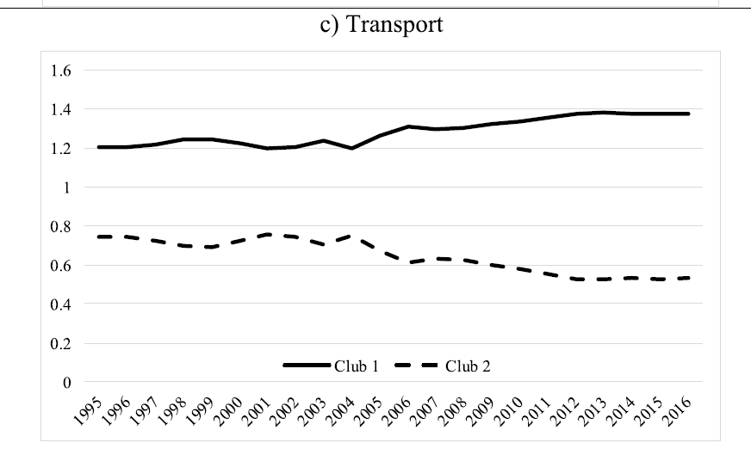

Slide 27
Conclusion
A correct design of environmental taxation and its transborder effects can make the difference between achieving a specific environmental goal or not.
The difficulties of establishing a unique tax policy in the European Union.
A common market with a common monetary policy, but not a tax one, can lead to difficulties in adjusting economic circumstances from a centralised public policy perspective. Differences in tax burdens can lead to capital leakage, tax competition and a redistribution of sources of environmental impacts among Member States, rather than reduction of them, offsetting other environmental policies in the EU.

Slide 28
Carbon tax explained
https://www.youtube.com/watch?v=EbF4s2LF_kg

Slide 29
Thank you! Questions?

Slide 30
Optional video: about New Green Deal
https://www.youtube.com/watch?v=vAi12Ehvtpw

