Slide 1

Social Impact of COVID-19 Worldwide and in Kyrgyzstan:
Findings from the Life with Corona Study
Tilman Brück, Damir Esenaliev, Hanna Freudenreich and the whole Life with Corona Study team
Online Conference 'The COVID-19 Crisis and its Impact on Post-Soviet Central Asia’
19 November 2020
https://lifewithcorona.org @LwC_survey

Slide 2
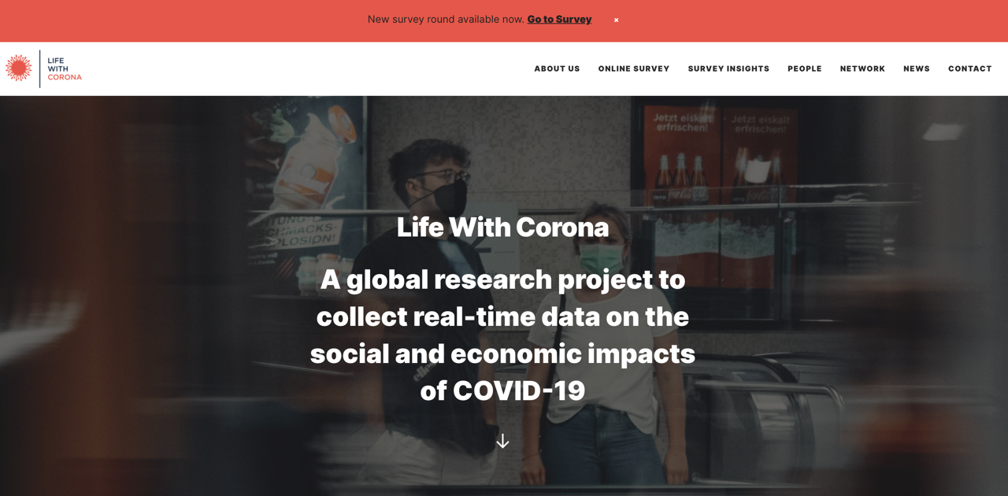

Slide 3
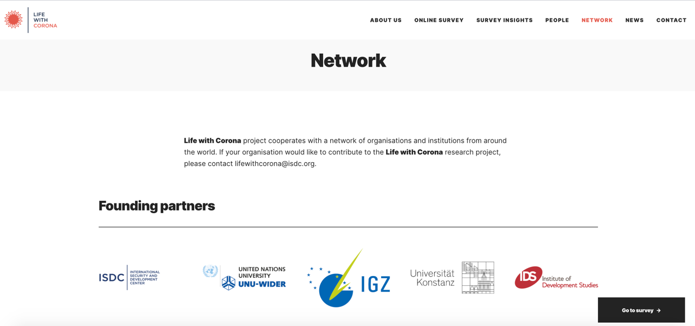

Slide 4
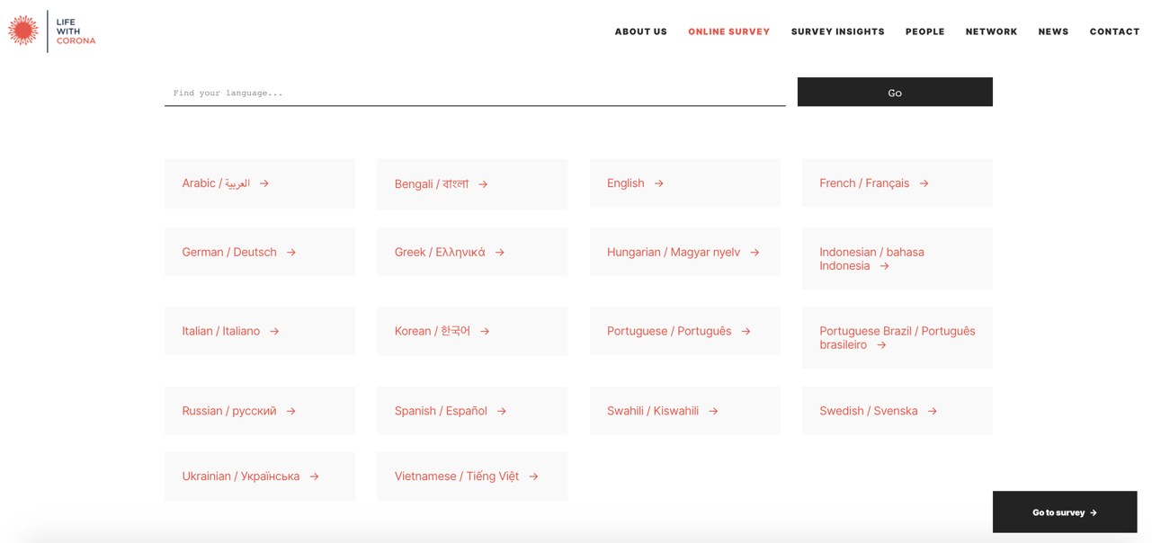

Slide 5
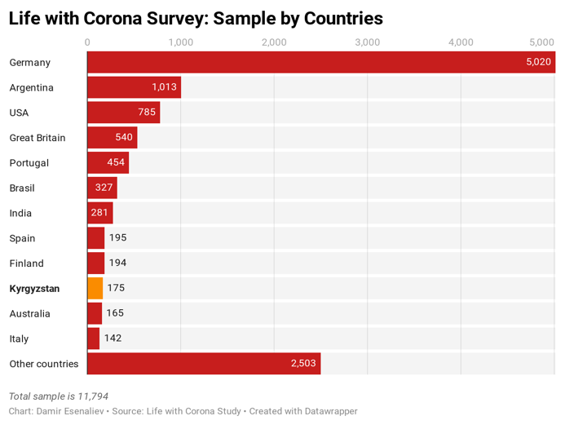
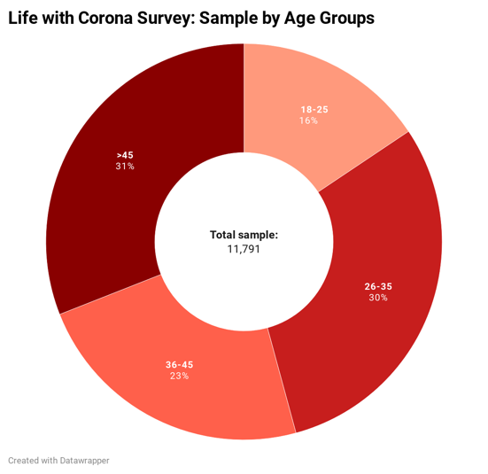

Slide 6
Six Findings from Six Months from the Global Life with Corona Online Survey
Source: https://lifewithcorona.org/six-months-report/

Slide 7
Six Findings from Round 1 of Life with Corona Study
Young adults actively perform many behaviours to counter the pandemic
Stress on families during the pandemic falls disproportionately on women who live with more than one other person
Older people are less stressed than younger people and are less worried about current circumstances
After the peak of COVID-related deaths, support for countermeasures drops
Around the world, people want global access to a vaccine – only in USA do a larger proportion support special access for their own country
Younger people are more willing to pay to stop the spread of the disease than older

Slide 8
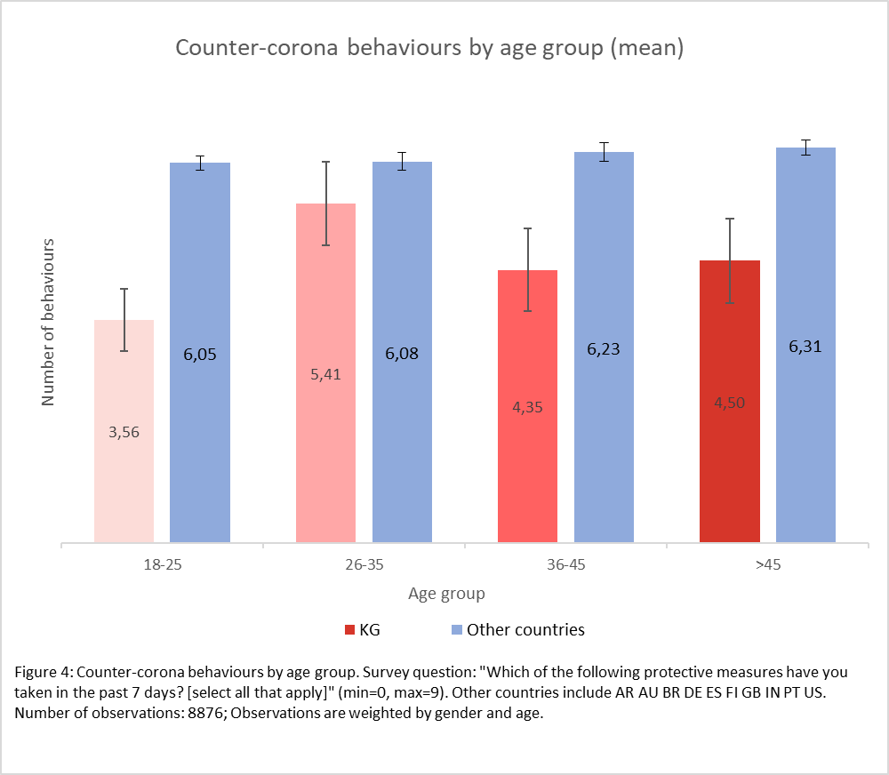
Finding 1: Compared to other countries, in Kyrgyzstan people undertake significantly less counter-coronavirus actions

Slide 9
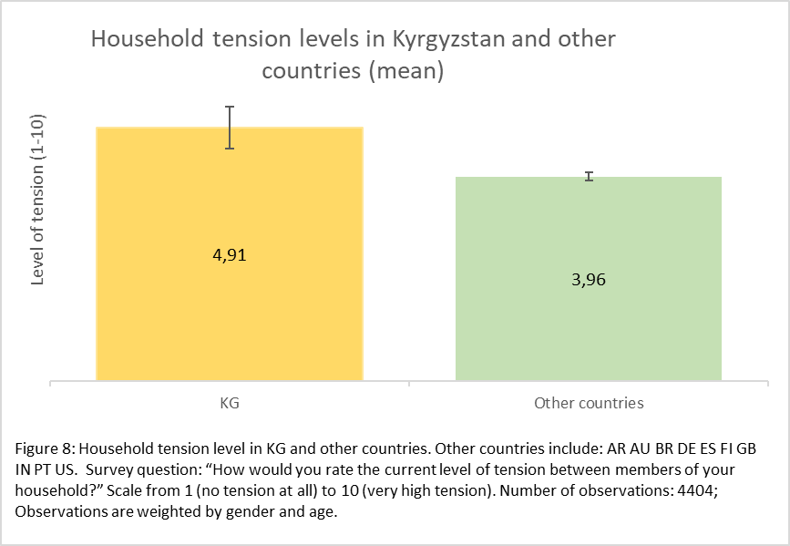
Finding 2: Tension in households is higher in Kyrgyzstan than in other countries surveyed

Slide 10
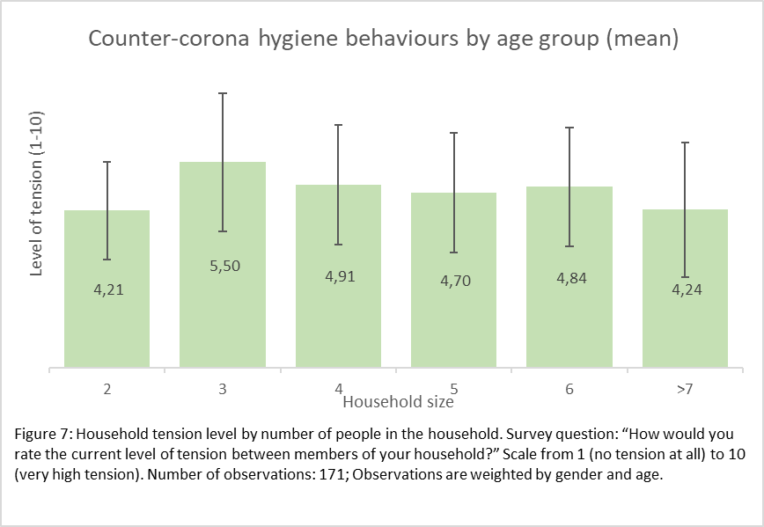
Finding 2: In Kyrgyzstan, household tension does not vary by household size
Within-household tensions by household size

Slide 11
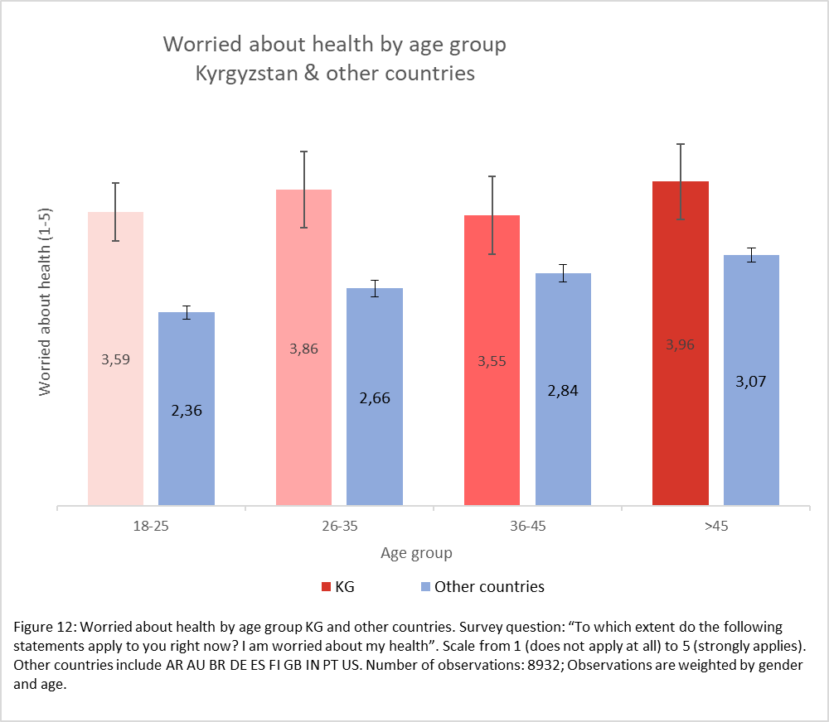
Finding 3: People in Kyrgyzstan are more worried about their health than people in other countries

Slide 12
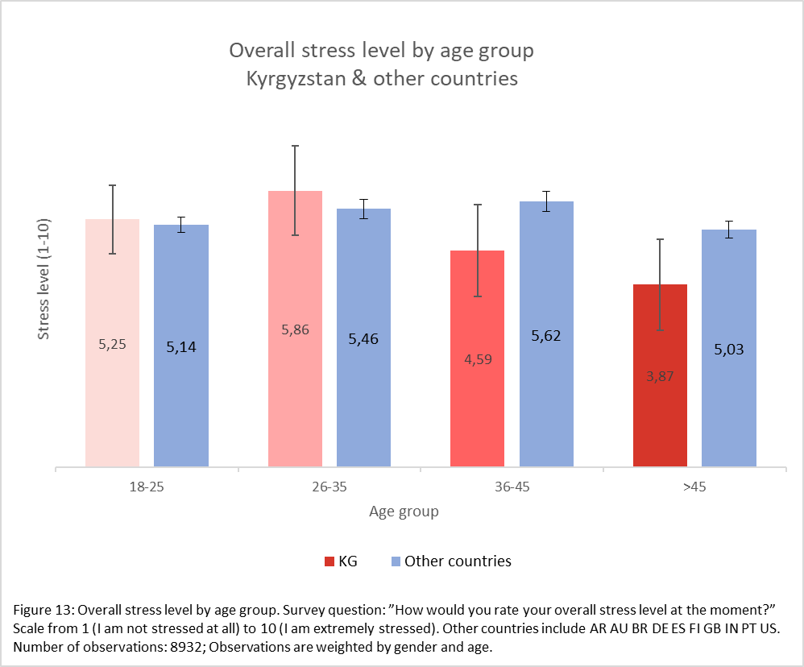
Finding 3: But older people are less stressed, both in Kyrgyzstan and elsewhere

Slide 13
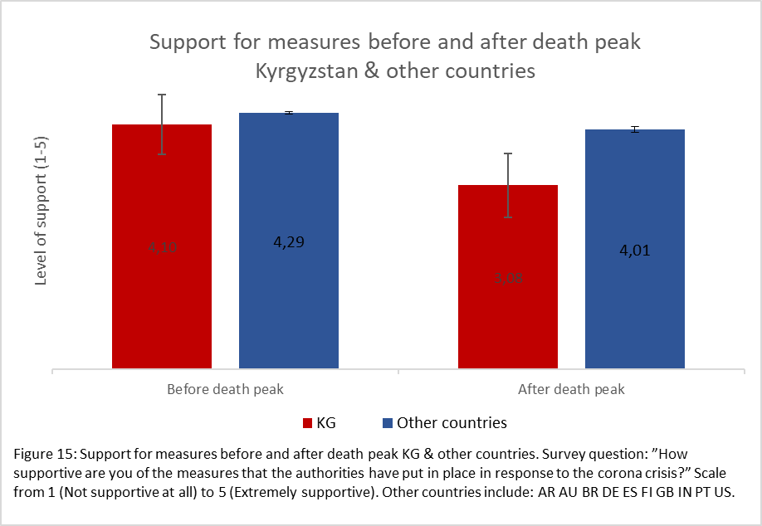
Finding 4: Support for countermeasures in Kyrgyzstan is lower than in other countries

Slide 14
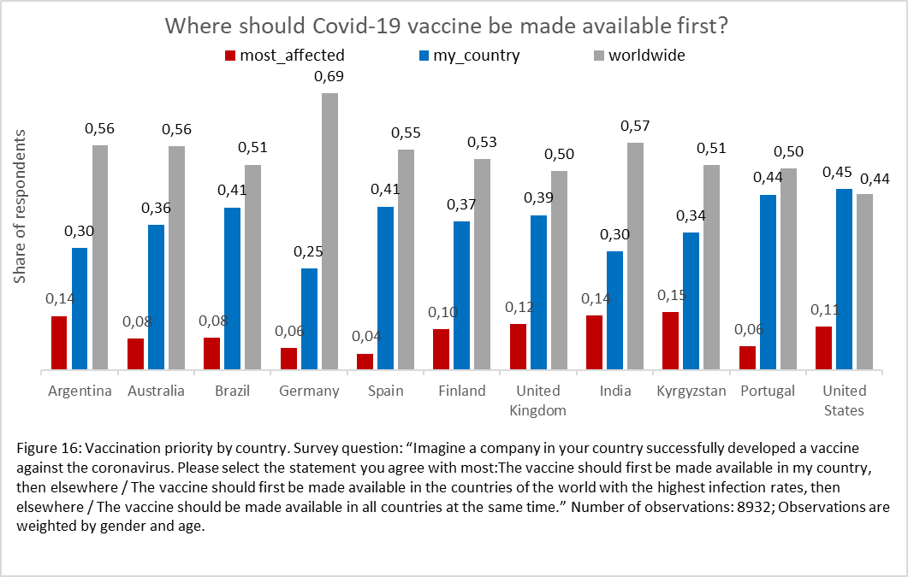
Finding 5: In Kyrgyzstan, the majority of people want global access to a vaccine, as elsewhere

Slide 15
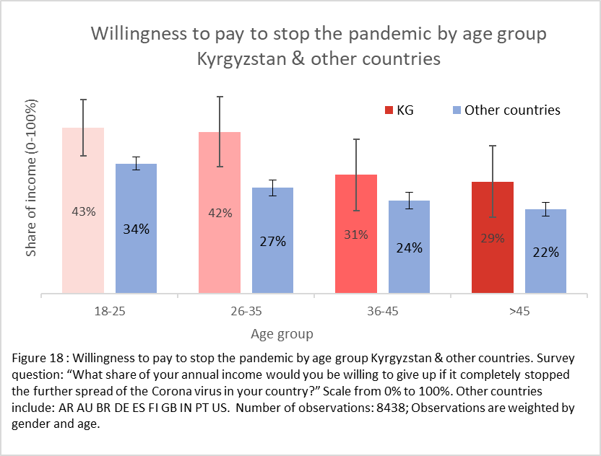
Finding 6: In fact, younger people in the world are willing to pay more to stop the virus

Slide 16
How Kyrgyzstan compares to other top-responded countries in the Life with Corona Survey?
Compared to other countries, in Kyrgyzstan people undertake significantly less counter-coronavirus actions
Tension in households is higher in Kyrgyzstan than in other countries surveyed
People in Kyrgyzstan are more worried about their health than people in other countries
Support for countermeasures in Kyrgyzstan is lower than in other countries
In Kyrgyzstan, the majority of people want global access to a vaccine, as elsewhere
Younger people in Kyrgyzstan are also willing to pay more to stop the virus

Slide 17
Please take the survey at www.lifewithcorona.org.
Thank you!

